Slide 1

Revenge of the S&Ls:
How Banks Lost a Half Trillion Dollars during 2022
Brian Silverstein
University of South Carolina
23rd Annual FDIC Bank Research Conference
September 19, 2024

Slide 2
Revenge of the S&Ls:
How Banks Lost a Half Trillion Dollars during 2022
Rebel A. Cole
Florida Atlantic University
Brian Silverstein
University of South Carolina
Jon R. Taylor
Michigan State University
Susan M. Wachter
University of Pennsylvania
Lawrence J. White
New York University

Slide 3
Summary
In 2022, U.S. banks saw $600B+ in unrealized losses on their security portfolios as the Fed raised rates by 400 bps to fight inflation.
This mirrors the early 1980s S&L crisis, where rising rates led to similar losses, despite post-crisis regulatory reforms.

Slide 4
Summary
In this study, we analyzed bank investments in various securities (Treasuries, Munis, RMBS, CMBS) and mortgages (commercial/residential) in explaining losses.
We find that RMBS investments were the most pernicious during 2020-2021, driven by yield-seeking amid pandemic deposit inflows.
We also investigated if equity markets priced these losses, and, if not, whether there is a need for better regulatory oversight of interest rate risk.

Slide 5
A Tale of Two Banking Crises:
2008 and 2023
On Mar. 10, 2023, Silicon Valley Bank was closed by its regulators, sparking a wave of contagion that threatened to spread throughout the banking system.
At the time, many called it a “Lehman moment,” in reference to the bankruptcy filing by the investment bank Lehman Brothers on Sep. 15, 2008, that ushered in the near collapse of the U.S. financial system.

Slide 6
A Tale of Two Banking Crises:
2008 and 2023
These two events had little in common:
  SVB was a commercial bank; LB was an investment bank.
  Their failures had fundamentally different causes:
    SVB failed due to securities losses from interest rate risk.
    LB failed due to securities losses from credit risk.
Notes:
Similarities risk management

Slide 7
A Tale of Two Banking Crises:
2008 and 2023
When we look at the number of bank failures by year, we see only one crisis:
  2008-2014.
  507 banks failed.
During 2023, there were only five bank failures.

Slide 8
A Tale of Two Banking Crises:
2008 and 2023
When we look at the assets of bank failures by year, we now see two crises:
  2008-2012: $689 billion.
  2023: $549 billion.

Slide 9
The 2023 Banking Crisis
Surprisingly, there was no banking crisis during the 2020 – 2021 in response to the COVID-19 pandemic.
Unemployment spiked, and GDP plummeted.
The Federal Government propped up the U.S. economy with a wide array of relief programs, injecting trillions of dollars into the economy.

Slide 10
The 2023 Banking Crisis:
Fiscal Stimulus
However, this massive deficit spending during the pandemic period by the federal government continued into 2022 and 2023.
$6 Trillion during 2020-2021. Another $3 Trillion during 2022-2023.
Much of this fiscal stimulus ended up as bank deposits.

Slide 11
The 2023 Banking Crisis:
Inflation
Fiscal stimulus led to rising inflation.
The Fed and Treasury initially deemed inflation "transitory" and expected it to subside.
Inflation accelerated in 2022, peaking at 8.9% in June, forcing decisive Fed action.

Slide 12
The 2023 Banking Crisis:
The Fed’s Response to Rising Inflation
In early 2020, the Fed cut rates from 2.5% to 0.08%.
Starting in March 2022, the target Fed Funds Rate increased from 0.08% to 5.33% by August 2023.
This was the fastest rate increase in the Fed’s history.
Source: Federal Reserve Economic Data (FRED)

Slide 13
The 2023 Banking Crisis:
The Bond Market’s Response to Rising Inflation
The Treasury-bond market responded to rising inflation in 2021.
10-Year bond yields rose to 2.0% before the first Fed rate hike in March 2022.
Yields peaked at 5.0% in October 2023, retreating to around 3.8% today.
Source: Federal Reserve Economic Data (FRED)

Slide 14
The 2023 Banking Crisis:
Deposit Inflows during the Pandemic
During 2020, total deposits grew by more than $3 Trillion, from $13 Trillion to $16 Trillion.
Over $2 trillion of deposit inflows were invested in securities.
This raised bank-owned securities by over 50%, from $3.6 trillion in 2019 to $5.6 trillion in 2021.
Notes:
During 2021, deposits grew another $2 Trillion.

Slide 15
The 2023 Banking Crisis:
Repricing Maturity Expansion
During 2020 & 2021, Banks, in aggregate, increased interest risk in security portfolios.
Prior to 2020, banks, on average, maintained repricing maturities at 7.2 years.
At the end of 2021, the average bank repricing maturity was up ~22% to 8.8 years.
Notes:
During 2021, deposits grew another $2 Trillion.

Slide 16
The 2023 Banking Crisis:
How did rising rates affect banks?
Banks were caught off guard by rising T-bond yields in 2022-2023.
Unrealized losses on securities surged from:
  $28 billion in Q4 2021 to
  $470 billion in Q2 2022 and
  $690 billion in Q3 2022.
These losses exceed 50% of regulatory capital at over 500 banks, including 100 banks with more than $1 billion in assets.

Slide 17
The 2023 Banking Crisis:
Silicon Valley Bank
On the morning of March 10, 2023, regulators unexpectedly closed Silicon Valley Bank, triggering fears of systemic contagion.
SVB, the 13th largest U.S. bank with over $200 billion in assets, became the second-largest bank failure in U.S. history.
The Friday morning closure hinted at regulatory unpreparedness.

Slide 18
The 2023 Banking Crisis:
Fallout from SVB’s closure
SVB wasn’t alone in facing unrealized losses and over-reliance on uninsured deposits.
Many large regional banks had similar vulnerabilities, which depositors and investors quickly recognized.
On March 10, regional bank stocks plummeted, triggering depositor runs at multiple banks.

Slide 19
The 2023 Banking Crisis:
Fallout from SVB’s closure
Signature Bank of NY, the 19th largest U.S. bank with $100 billion in assets, catered to crypto businesses.
  Regulators closed the bank on March 12, making it the third-largest bank failure in U.S. history.
First Republic Bank, the 12th largest U.S. bank with $212 billion in assets, had significant real estate exposure.
  Regulators closed FRB on May 1, marking FRB the second largest bank failure in U.S. history.

Slide 20
The 2023 Banking Crisis:
Residential Mortgages
Rising interest rates have devalued both banks' security portfolios and their $2.5 trillion in residential mortgages (primarily 30-year fixed-rate).
As of Q2 2024, unrealized losses on these mortgages could reach an additional $250 billion, based on RMBS loss trends.

Slide 21
The 2023 Banking Crisis:
Commercial Mortgages
Rising interest rates are expected to cause significant losses on banks' $2.5 trillion commercial mortgage portfolios.
These typically have 5-year terms, with half maturing in the next 24 months, requiring refinancing.
Existing rates of 3-4% have risen to 7-10%, rendering many properties cash-flow negative.

Slide 22
The 2023 Banking Crisis:
Commercial Real Estate Appreciation
This chart shows the quarterly change in CRE property values based upon the benchmark NCREIF index.
Note that property values have only fallen three times in the past 45 years:
  Early 1990s
  2008-2009
  2022-2023

Slide 23
The 2023 Banking Crisis:
Commercial Mortgages
Of the 156 banks with more than $10 billion in assets, 50 have CRE exposure greater than 300% of their regulatory capital.
Among all 4,697 banks:
  1,646 have CRE exposure greater than 300%
  899 have exposures greater than 400%, and
  404 have exposures greater than 500%.
Regulators consider 300% to be excessive asset concentration.

Slide 24

Methodology:
Unrealized Securities Losses
We estimate a series of OLS regressions where the dependent variable is the ratio of unrealized securities losses to total assets and the explanatory variables are bank portfolio allocations of their assets to different types of securities and mortgages:
${loss ratio}_{i}= β0$
$$+ β1×treasectai +β2×munisectai$$
$$+ β3×rmbstai+β4×cmbstai$$
$$+β5×resmorttai +β6×cremorttai+ei$$

Slide 25

Methodology:
Unrealized Securities Losses
${loss ratio}_{i}$ is the ratio of unrealized security losses to assets;
$treasecta i$is the ratio of Treasury securities to assets;
$munisectai$is the ratio of municipal securities to assets;
$rmbstai$is the ratio of residential mortgage-backed securities (RMBS) to assets;
$cmbstai$is the ratio of commercial mortgage-backed securities (CMBS) to assets;
$resmorttai$ is the ratio of residential mortgages to assets;
$cremorttai$is the ratio of commercial mortgages to assets; and
$ei$ is an i.i.d error term.

Slide 26
Descriptive Statistics
Table 1: This table shows descriptive statistics for the following variables. $seclossta$ is the ratio of unrealized securities losses (expressed as a positive value) to total assets. These statistics are based upon quarterly financial data reported by 4,697 U.S. commercial banks for Q2 2023.

Slide 27
Descriptive Statistics
By Ratio of Securities Losses to Assets
Table 2: This table shows descriptive statistics and differences in means of banks with below and above median securities losses (as a percentage of total assets).

Slide 28
Correlations
Table 3: This table shows the correlation coefficients for the following variables.
These correlations are based upon quarterly financial data reported by 4,697 U.S. commercial banks for Q2 2023.

Slide 29
Correlations
Table 3: This table shows the correlation coefficients for the following variables.
These correlations are based upon quarterly financial data reported by 4,697 U.S. commercial banks for Q2 2023.

Slide 30

Regression Results: Determinants of
Securities Losses to Total Assets
Table 4: This table shows the results from a series of OLS regressions where the dependent variable is $seclossta$, which is the ratio of unrealized securities losses (expressed as a positive value) to total assets. These regressions are based upon quarterly financial data reported by 4,697 U.S. commercial banks for Q2 2023. Explanatory variables are based upon quarterly financial data reported by 4,697 banks for Q4 2021, prior to the first interest rate hike. t-statistics appear in parenthesis. *,**, and *** indicate statistical significance at the 10, 5, and 1 percent levels, respectively.

Slide 31
Regression Results: Determinants of
Securities Losses to Total Assets
Table 4: This table shows the results from a series of OLS regressions where the dependent variable is $seclossta$, which is the ratio of unrealized securities losses (expressed as a positive value) to total assets. These regressions are based upon quarterly financial data reported by 4,697 U.S. commercial banks for Q2 2023. Explanatory variables are based upon quarterly financial data reported by 4,697 banks for Q4 2021, prior to the first interest rate hike. t-statistics appear in parenthesis. *,**, and *** indicate statistical significance at the 10, 5, and 1 percent levels, respectively.

Slide 32
Event-Study Analysis of SVB Closure:
Next, we test whether the sharp declines in bank stock values following Silicon Valley Bank's March 10, 2023, failure reflected disproportionate losses among banks exposed to interest-rate risk.
  First, we estimate excess returns around the failure by regressing daily bank stock returns against the S&P 500.
  Second, we analyze the cumulative abnormal returns (CARs) using the ratio of unrealized securities losses to total assets and portfolio allocations as key explanatory variables.

Slide 33
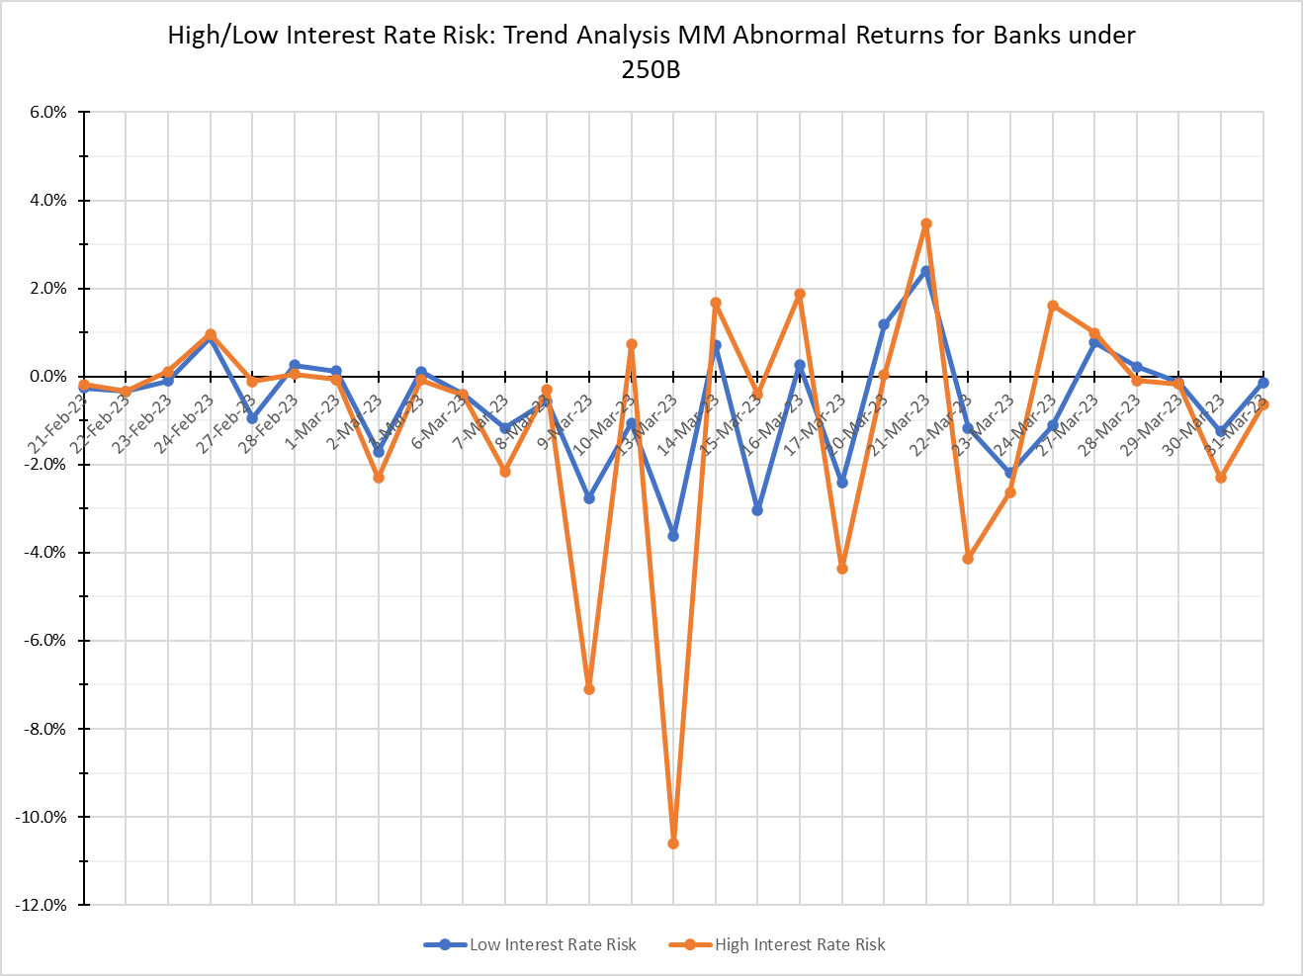
Event-Study Analysis of SVB Closure:
High vs. Low Interest-Rate Risk Portfolios
Average daily abnormal returns of Bank Holding Companies (BHCs)
with high and low interest-rate risk in their security portfolios.

Slide 34
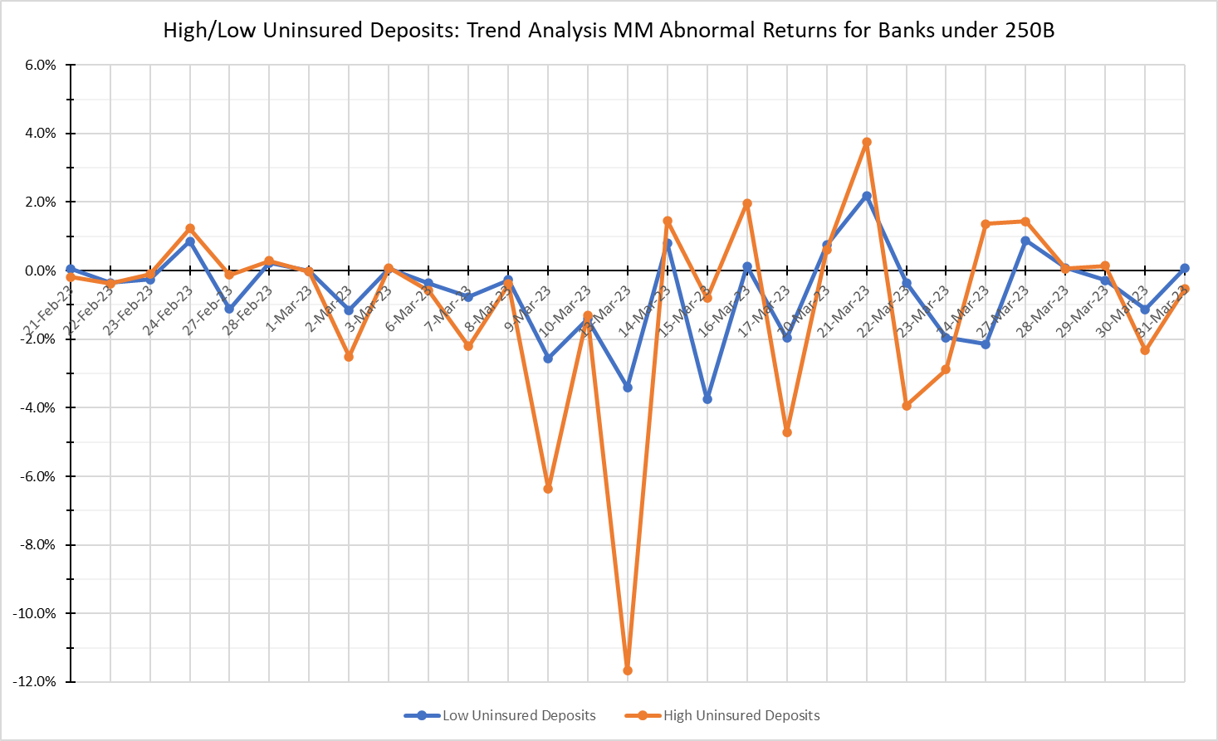
Event-Study Analysis of SVB Closure:
High vs. Low Uninsured Deposits
Average daily abnormal returns of Bank Holding Companies (BHCs)
with high and low uninsured deposits.

Slide 35
Diff-in-Diff Analysis of Daily Abnormal Returns:
 | Interest rate Risk |  |  |  | Uninsured Deposits |  |  |  | Unrealized Losses |  |  |  | Combined
 | (1) |  | (2) |  | (3) |  | (4) |  | (5) |  | (6) |  | (7) |  | (8)
High_Int_Risk ×Post SVB Failure | -8.84 |  | -7.569 |  |  |  |  |  |  |  |  |  | -11.09 |  | -9.263
 | (-1.164) |  | (-1.010) |  |  |  |  |  |  |  |  |  | (-1.363) |  | (-1.149)
High_Int_Risk | 2.356 |  | 1.987 |  |  |  |  |  |  |  |  |  | 1.356 |  | 1.345
 | -0.867 |  | -0.779 |  |  |  |  |  |  |  |  |  | -0.472 |  | -0.492
High Uninsured x Post SVB |  |  |  |  | -25.069 | *** | -19.016 | ** |  |  |  |  | -24.572 | *** | -18.601 | **
 |  |  |  |  | (-2.990) |  | (-2.290) |  |  |  |  |  | (-2.990) |  | (-2.287)
High Uninsured Dep |  |  |  |  | -6.555 | ** | -4.883 | * |  |  |  |  | -6.619 | ** | -4.947 | *
 |  |  |  |  | (-2.308) |  | (-1.811) |  |  |  |  |  | (-2.312) |  | (-1.816)
High Unrealized Loss x Post SVB |  |  |  |  |  |  |  |  | 0.081 |  | -0.359
 |  |  |  |  |  |  |  |  | -0.011 |  | (-0.048)
High Unreal Losses |  |  |  |  |  |  |  |  | -3.411 |  | -3.178
 |  |  |  |  |  |  |  |  | (-1.253) |  | (-1.241)
Post SVB | -83.712 | *** | -63.033 | *** | -79.263 | *** | -59.645 | *** | -88.246 | *** | -66.698 | *** | -73.983 | *** | -55.234 | ***
 | (-19.755) |  | (-14.868) |  | (-19.759) |  | (-14.230) |  | (-19.652) |  | (-15.051) |  | (-13.228) |  | (-9.418)
Constant | -14.375 | *** | -6.987 | *** | -10.826 | *** | -4.037 | * | -11.44 | *** | -4.358 | ** | -11.472 | *** | -4.677 | **
 | (-7.740) |  | (-4.045) |  | (-4.767) |  | (-1.873) |  | (-5.582) |  | (-2.210) |  | (-4.634) |  | (-2.030)
R-Squared | 0.029 |  | 0.020 |  | 0.033 |  | 0.023 |  | 0.029 |  | 0.020 |  | 0.033 |  | 0.023
N | 11,749 |  | 11,749 |  | 10,447 |  | 10,447 |  | 11,749 |  | 11,749 |  | 10,447 |  | 10,447
Post SVB failure equals on from March 9, 2023, through March 31, 2023, and zero before this period.
BHC daily abnormal returns calculated using CAPM and Fama-French three factor model multiplied by 100.

Slide 36
Diff-in-Diff Analysis of Daily Abnormal Returns:
 | Interest rate Risk |  |  |  | Uninsured Deposits |  |  |  | Unrealized Losses |  |  |  | Combined
 | (1) |  | (2) |  | (3) |  | (4) |  | (5) |  | (6) |  | (7) |  | (8)
High_Int_Risk ×Post SVB Failure | -8.84 |  | -7.569 |  |  |  |  |  |  |  |  |  | -11.09 |  | -9.263
 | (-1.164) |  | (-1.010) |  |  |  |  |  |  |  |  |  | (-1.363) |  | (-1.149)
High_Int_Risk | 2.356 |  | 1.987 |  |  |  |  |  |  |  |  |  | 1.356 |  | 1.345
 | -0.867 |  | -0.779 |  |  |  |  |  |  |  |  |  | -0.472 |  | -0.492
High Uninsured x Post SVB |  |  |  |  | -25.069 | *** | -19.016 | ** |  |  |  |  | -24.572 | *** | -18.601 | **
 |  |  |  |  | (-2.990) |  | (-2.290) |  |  |  |  |  | (-2.990) |  | (-2.287)
High Uninsured Dep |  |  |  |  | -6.555 | ** | -4.883 | * |  |  |  |  | -6.619 | ** | -4.947 | *
 |  |  |  |  | (-2.308) |  | (-1.811) |  |  |  |  |  | (-2.312) |  | (-1.816)
High Unrealized Loss x Post SVB |  |  |  |  |  |  |  |  | 0.081 |  | -0.359
 |  |  |  |  |  |  |  |  | -0.011 |  | (-0.048)
High Unreal Losses |  |  |  |  |  |  |  |  | -3.411 |  | -3.178
 |  |  |  |  |  |  |  |  | (-1.253) |  | (-1.241)
Post SVB | -83.712 | *** | -63.033 | *** | -79.263 | *** | -59.645 | *** | -88.246 | *** | -66.698 | *** | -73.983 | *** | -55.234 | ***
 | (-19.755) |  | (-14.868) |  | (-19.759) |  | (-14.230) |  | (-19.652) |  | (-15.051) |  | (-13.228) |  | (-9.418)
Constant | -14.375 | *** | -6.987 | *** | -10.826 | *** | -4.037 | * | -11.44 | *** | -4.358 | ** | -11.472 | *** | -4.677 | **
 | (-7.740) |  | (-4.045) |  | (-4.767) |  | (-1.873) |  | (-5.582) |  | (-2.210) |  | (-4.634) |  | (-2.030)
R-Squared | 0.029 |  | 0.020 |  | 0.033 |  | 0.023 |  | 0.029 |  | 0.020 |  | 0.033 |  | 0.023
N | 11,749 |  | 11,749 |  | 10,447 |  | 10,447 |  | 11,749 |  | 11,749 |  | 10,447 |  | 10,447
Post SVB failure equals on from March 9, 2023, through March 31, 2023, and zero before this period.
BHC daily abnormal returns calculated using CAPM and Fama-French three factor model multiplied by 100.

Slide 37
Diff-in-Diff Analysis of Daily Abnormal Returns:
 | Interest rate Risk |  |  |  | Uninsured Deposits |  |  |  | Unrealized Losses |  |  |  | Combined
 | (1) |  | (2) |  | (3) |  | (4) |  | (5) |  | (6) |  | (7) |  | (8)
High_Int_Risk ×Post SVB Failure | -8.84 |  | -7.569 |  |  |  |  |  |  |  |  |  | -11.09 |  | -9.263
 | (-1.164) |  | (-1.010) |  |  |  |  |  |  |  |  |  | (-1.363) |  | (-1.149)
High_Int_Risk | 2.356 |  | 1.987 |  |  |  |  |  |  |  |  |  | 1.356 |  | 1.345
 | -0.867 |  | -0.779 |  |  |  |  |  |  |  |  |  | -0.472 |  | -0.492
High Uninsured x Post SVB |  |  |  |  | -25.069 | *** | -19.016 | ** |  |  |  |  | -24.572 | *** | -18.601 | **
 |  |  |  |  | (-2.990) |  | (-2.290) |  |  |  |  |  | (-2.990) |  | (-2.287)
High Uninsured Dep |  |  |  |  | -6.555 | ** | -4.883 | * |  |  |  |  | -6.619 | ** | -4.947 | *
 |  |  |  |  | (-2.308) |  | (-1.811) |  |  |  |  |  | (-2.312) |  | (-1.816)
High Unrealized Loss x Post SVB |  |  |  |  |  |  |  |  | 0.081 |  | -0.359
 |  |  |  |  |  |  |  |  | -0.011 |  | (-0.048)
High Unreal Losses |  |  |  |  |  |  |  |  | -3.411 |  | -3.178
 |  |  |  |  |  |  |  |  | (-1.253) |  | (-1.241)
Post SVB | -83.712 | *** | -63.033 | *** | -79.263 | *** | -59.645 | *** | -88.246 | *** | -66.698 | *** | -73.983 | *** | -55.234 | ***
 | (-19.755) |  | (-14.868) |  | (-19.759) |  | (-14.230) |  | (-19.652) |  | (-15.051) |  | (-13.228) |  | (-9.418)
Constant | -14.375 | *** | -6.987 | *** | -10.826 | *** | -4.037 | * | -11.44 | *** | -4.358 | ** | -11.472 | *** | -4.677 | **
 | (-7.740) |  | (-4.045) |  | (-4.767) |  | (-1.873) |  | (-5.582) |  | (-2.210) |  | (-4.634) |  | (-2.030)
R-Squared | 0.029 |  | 0.020 |  | 0.033 |  | 0.023 |  | 0.029 |  | 0.020 |  | 0.033 |  | 0.023
N | 11,749 |  | 11,749 |  | 10,447 |  | 10,447 |  | 11,749 |  | 11,749 |  | 10,447 |  | 10,447
Post SVB failure equals on from March 9, 2023, through March 31, 2023, and zero before this period.
BHC daily abnormal returns calculated using CAPM and Fama-French three factor model multiplied by 100.

Slide 38
Diff-in-Diff Analysis of Daily Abnormal Returns:
 | Interest rate Risk |  |  |  | Uninsured Deposits |  |  |  | Unrealized Losses |  |  |  | Combined
 | (1) |  | (2) |  | (3) |  | (4) |  | (5) |  | (6) |  | (7) |  | (8)
High_Int_Risk ×Post SVB Failure | -8.84 |  | -7.569 |  |  |  |  |  |  |  |  |  | -11.09 |  | -9.263
 | (-1.164) |  | (-1.010) |  |  |  |  |  |  |  |  |  | (-1.363) |  | (-1.149)
High_Int_Risk | 2.356 |  | 1.987 |  |  |  |  |  |  |  |  |  | 1.356 |  | 1.345
 | -0.867 |  | -0.779 |  |  |  |  |  |  |  |  |  | -0.472 |  | -0.492
High Uninsured x Post SVB |  |  |  |  | -25.069 | *** | -19.016 | ** |  |  |  |  | -24.572 | *** | -18.601 | **
 |  |  |  |  | (-2.990) |  | (-2.290) |  |  |  |  |  | (-2.990) |  | (-2.287)
High Uninsured Dep |  |  |  |  | -6.555 | ** | -4.883 | * |  |  |  |  | -6.619 | ** | -4.947 | *
 |  |  |  |  | (-2.308) |  | (-1.811) |  |  |  |  |  | (-2.312) |  | (-1.816)
High Unrealized Loss x Post SVB |  |  |  |  |  |  |  |  | 0.081 |  | -0.359
 |  |  |  |  |  |  |  |  | -0.011 |  | (-0.048)
High Unreal Losses |  |  |  |  |  |  |  |  | -3.411 |  | -3.178
 |  |  |  |  |  |  |  |  | (-1.253) |  | (-1.241)
Post SVB | -83.712 | *** | -63.033 | *** | -79.263 | *** | -59.645 | *** | -88.246 | *** | -66.698 | *** | -73.983 | *** | -55.234 | ***
 | (-19.755) |  | (-14.868) |  | (-19.759) |  | (-14.230) |  | (-19.652) |  | (-15.051) |  | (-13.228) |  | (-9.418)
Constant | -14.375 | *** | -6.987 | *** | -10.826 | *** | -4.037 | * | -11.44 | *** | -4.358 | ** | -11.472 | *** | -4.677 | **
 | (-7.740) |  | (-4.045) |  | (-4.767) |  | (-1.873) |  | (-5.582) |  | (-2.210) |  | (-4.634) |  | (-2.030)
R-Squared | 0.029 |  | 0.020 |  | 0.033 |  | 0.023 |  | 0.029 |  | 0.020 |  | 0.033 |  | 0.023
N | 11,749 |  | 11,749 |  | 10,447 |  | 10,447 |  | 11,749 |  | 11,749 |  | 10,447 |  | 10,447
Post SVB failure equals on from March 9, 2023, through March 31, 2023, and zero before this period.
BHC daily abnormal returns calculated using CAPM and Fama-French three factor model multiplied by 100.

Slide 39
Summary and Conclusions
We analyzed the factors driving banks' unrealized losses on securities portfolios.
We find that these losses are linked to holdings in RMBS and Treasuries, with RMBS causing twice the losses per dollar compared to Treasuries.
“Reaching for yield” by banks led to significant losses, especially due to the longer durations and higher initial yields of RMBS.

Slide 40
Summary and Conclusions
We also find that these losses are negatively associated with banks' holdings of residential and commercial mortgages.
Banks that were lending had much smaller exposures to securities, especially to long-duration RMBS.
However, unrealized losses on residential mortgages are likely to be similar in magnitude to those on RMBS.
Future losses on commercial mortgages are uncertain, with over $1 trillion maturing next year.

Slide 41
Summary and Conclusions
Finally, we find that, following the failure of SVB, equity markets focused on banks' uninsured deposits rather than interest-rate risk or unrealized losses.
However, the risk for certain banks post-SVB stemmed from a combination of unrealized losses and uninsured deposits.

Slide 42
Thank you!

