Slide 1
Digital Banking to Fintech:
Financial Services Innovation & AI-Driven Banking

Slide 2
Paper 33: Digital Banking Revolution: Effects on Competition and Stability
Digital banking platforms increase competition in the banking sector and pose risks to financial stability. Digitalization decreases local and national market concentration, and average markups fall in deposit and loan markets, holding fixed the size of the banking sector. As for stability, it increases the average market share of lightly-regulated mid-sized banks by 29%, increases the uninsured deposits ratio of the banking sector by 9% while resorting uninsured deposits towards larger digital banks, and doubles credit risks associated with lending in market segments that are less-well served by digital technologies.
In sum, digital banking increases competition and poses risks to financial stability.
Digitalization completely transformed financial services and injected characteristics of tech-driven industries.
Digital platforms have the platform to increase competition by allowing mid-sized firms to compete more effectively with the physical infrastructure of the largest firms.
This is due to the cloud service providers.
Digitalization costs and differentiation can hurt the profitability and business models of small community banks with below $10B in assets.
2. Digital Banking has implications for monetary policy transmission.
Digital banks attract a different and potentially flightier deposit base.
Globally, these trends can be observed in young customers, unbanked, underbanked etc
Digital banking also reduces the variable costs of deposit provision.
Koont et al. (2023) show that digital banks also face higher deposit outflows for each deposit market segment in response to increases in interest rates, leading to a lower deposit franchise value for a given level and composition of deposits.
3. Digital banking alters banks’ ability to screen or monitor customers across different market segments. This may lead to risk build up in market segments that are less well served via digital technologies.
The amount of customer monitoring directly or third party help is unprecedented. This is a very prominent factor esp in digital banking and fintech may not be clear externally.
a shift towards digital loan origination increases the banking system’s reliance on hard information, such as credit scores, and thus mistakes or mechanical changes in these metrics can lead to larger consequences
Digital footprint usage is not highly regulated in fintech. There are ethical risks as well. Limited science behind the use of markers.
increased use of hard information in lending decisions could alter the correlation among banks’ risks if for instance all banks are using the same data in credit decisions, which would have implications for stability.
Fintech considers all data as credit data. Globally, in fintech, credit decisioning based on phone charge levels, use of capital letters, typing speed, scores of your social media contacts, anything on mobile phone, (FDIC focused on the digital footprint based credit scoring in publications as well).
4. Branchless integration of local banking markets due to digital platform technologies is likely to affect the propagation of bank health shocks to more geographic regions, while also dampening the reliance of regions on any one specific institution.
Digitalization makes things more centralized and homogenized. Hence, smaller regional variations.
branch-based measures of market concentration will become less relevant going forward in assessing the competitive landscape of a local banking market, and highlights the need for clearer data on the locations of deposits and other banking services that need not be tied to the physical branches of banks.

Slide 3
Paper 198: Risk Externalities of Financial Innovation: Evidence from Operational Losses at Large U.S. Bank Holding Companies
Paper 198
Financial innovation is associated with adverse operational risk externalities.
Firms with more financial patent innovation suffered higher operational losses per dollar or assets and more tail risk events.
Banking organizations engaging in more financial innovation prior to or during the global financial crisis have more operational losses during the crisis. 2007-2009 crisis.
With the Rise of Digital Banking, Banks are Becoming Hybrid Technology Firms.
Banks now have (i) Large digital infrastructures (cloud deployments, mobile apps, cyber infrastructures, digital investment services etc).
All competing with technology providers like IBM, Microsoft, Amazon, etc.
They need to file patents to operate in digital banking also for AI/ML/data science use cases.
What Drove Finance’s Patenting?
America Invents Act - Expiration and Litigation Boom
“Historically, patent litigation activity in the financial services sector was largely initiated by non-practicing entities against banks. This trend was a major reason for the inclusion of the covered business method review program in the 2012 America Invents Act. But that program recently expired, and Bloomberg News found a threefold increase in lawsuits against financial institutions following its expiration.”
Competitor Lawsuits
USAA suing Wells Fargo, then PNC and others.
Patent Trolls Increasing lawsuits
Are Patents a Proxy for Financial Innovation? Is it the Wild West?
Patents as proxy for innovation is a challenging assumption in financial services. Banks largely miss Intellectual Property infrastructure and know-how compared to the technology sector.
History of patenting is very recent and few companies have accumulated a reasonable amount of patents for analysis. (3-4 large banks lead in financial patents).
Patents are approved through management lines and Lines-of-Business instead of firm-wide funding. The result is a localized, personalized pockets. Also strong issues in IP hygiene. Serious enforceability problems.
  Examples: M.D. who funds the group gets their name on the patent. Invalidates the patent completely.
  Firms change filings and disclosures add names after primary inventors leave the firm. Invalidates the patent.
  Large majority of financial service staff do not understand patent processes or patentability.
  Managing directors have extreme power delta over reports. Not amenable for innovation culture.
Recent Trends
The paper misses the more recent trends of banks increasing their patent counts since 2015. Over 30% year-to-year increase has been reported in the past decade. Some firms
2014 Alice Decision (electronic escrow patent) put a damper on business method filings. USPTO allowance of finance patents dropped after Alice decioning by 10%. There 2 camps now. One group aggressively filing more, the other group uninterested.

Slide 4
Paper 201: From Competitors to Partners: Banks’ Venture Investments in Fintech
Claim: We hypothesize and find evidence that banks use venture investments in fintech startups as a strategic approach to navigate fintech competition
Collaboration vs. Competition: U.S. vs APAC
In Asia Pacific fintech ecosystem have the power to challenge large financial institutions and reach their level in a collaborative fashion.
In the US. Fintechs operate as more collaboratively than competitively. In the U.S. challenger fintechs are rare.
Possible causes: VC relationships and partnerships with large banks
Bank VC functions, patent law protections and legal system.
Asian Fintech market is growing more
According to a report from BCG and QED Investors, APAC has a projected compound annual growth rate (CAGR) of 27%, whereas the US has an estimated CAGR of just 17%.
“Attractive demographics, native technology and engineering capabilities, and prudent regulations combined with the sheer necessity to innovate for accelerating the upliftment of a large mass of humanity make APAC the center of gravity for fintechs,” says Erande. [BCG Report]
Fintech is Taking Over: Fintech Growth 3x the Banking Sector
McKinsey’s research shows that revenues in the fintech industry are expected to grow almost three times faster than those in the traditional banking sector between 2023 and 2028.
According to Accenture financial services firms started seeing fintechs as opportunities in the recent years.
In 2015 the level of investment into collaborative companies increased by 138% while into competitive ones the growth was only 23%
xs
Rise of fintech is motivating the rise of patents in banking
Notes:
https://www.mckinsey.com/industries/financial-services/our-insights/fintechs-a-new-paradigm-of-growth
http://www.cee-fintech.com/index.php/2016/04/26/accenture-releases-a-report-on-the-evolving-landscape-of-fintech-ecosystem/
Banks’ Patenting as an Answer to Emerging Fintech and Bigtech Competition: A Cross-Country Empirical Study
Oskar Kowalewski, Paweł Pisany
Fintech, Pandemic, and the Financial System: Challenges and
Vives, X., 2017. The impact of FinTech on banking. European Economy, (2), pp.97-105.
Navaretti, G.B., Calzolari, G., Mansilla-Fernandez, J.M. and Pozzolo, A.F., 2018. Fintech and banking. Friends or foes?. Friends or Foes.
Murinde, V., Rizopoulos, E. and Zachariadis, M., 2022. The impact of the FinTech revolution on the future of banking: Opportunities and risks. International review of financial analysis, 81, p.102103.
[BCG Report] https://www.bcg.com/publications/2023/future-of-fintech-and-banking

Slide 5
Digital Banking Trends

Slide 6
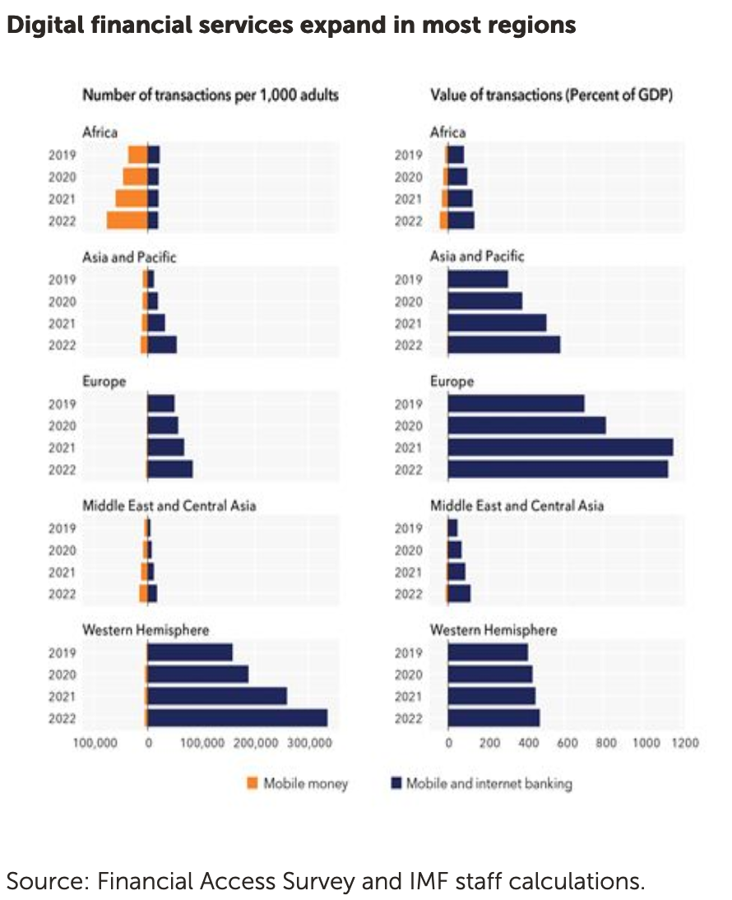
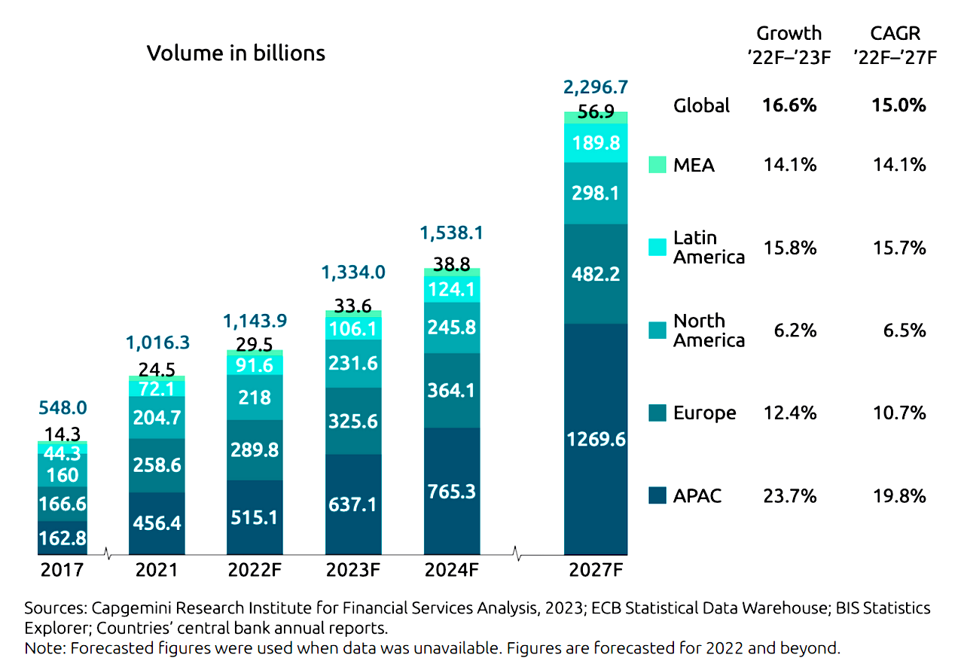
Digital Finance Transformed Financial Services Industry
Digital Payments Growth is Continuing
Source: Capgemini
Notes:
https://www.imf.org/en/News/Articles/2023/10/03/pr23332-imf-releases-the-2023-financial-access-survey-results

Slide 7
In-House Innovation
& Patenting
Partnership with
Collaborative Fintech
Mergers & Acquisitions
Competitive Fintech
Fintech
Fintech Growth
Rise of Digital Banking

Slide 8
The Rise of Fintech and Technology Firm Pressures

Slide 9



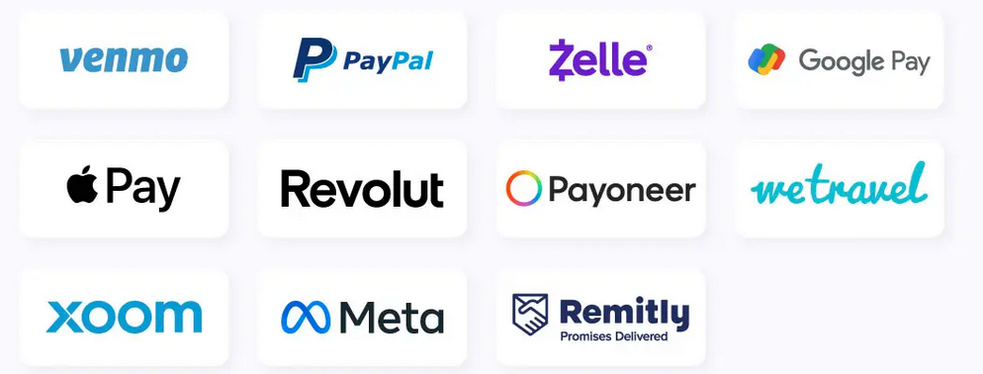
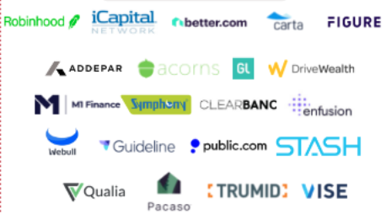
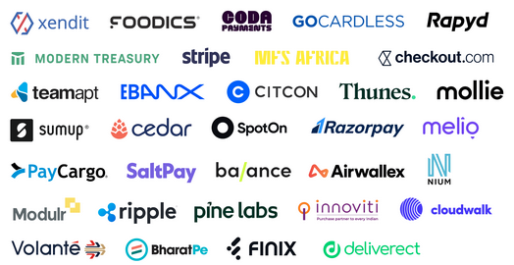

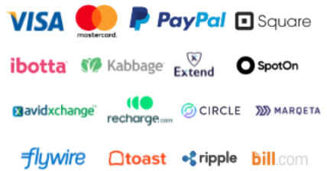


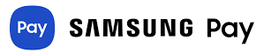
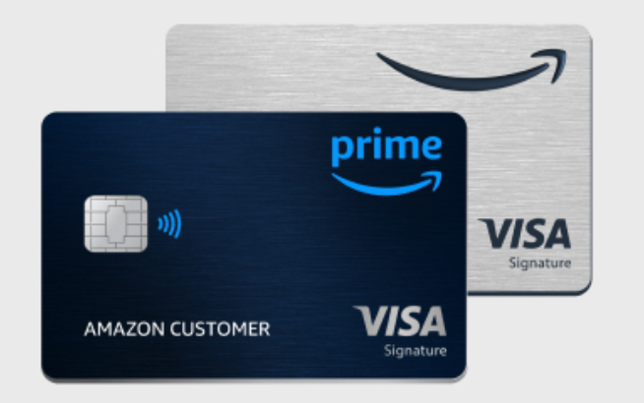
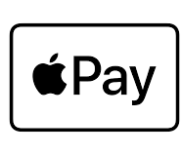


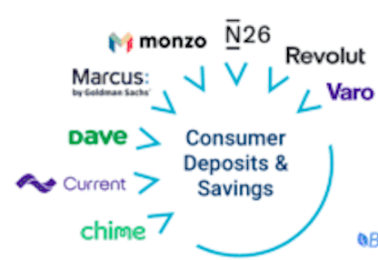



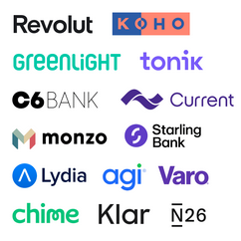







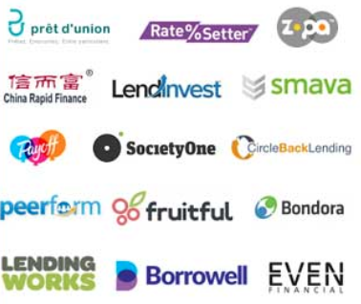
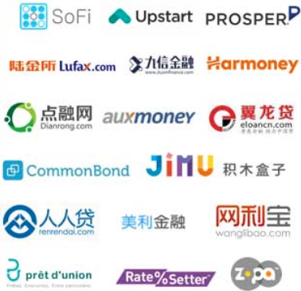
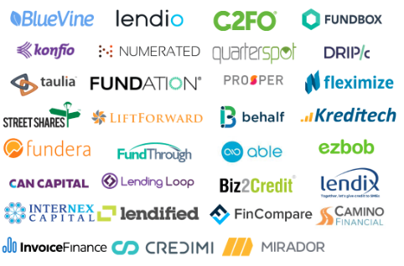
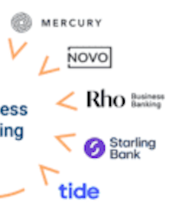
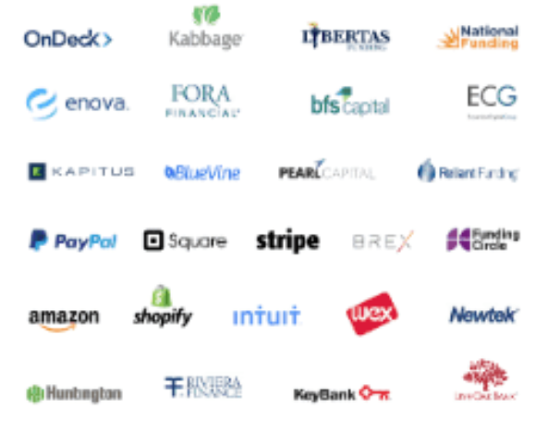
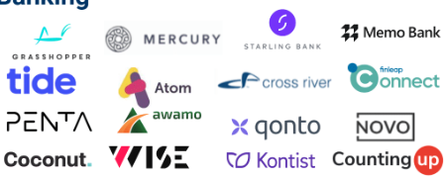

Consumer Payments
Investment Banking
Wealth & Investing
Consumer Deposits & Savings
Business Payments & Cards
Banks
SMB Lending
Consumer Lending
Business Banking

Slide 10
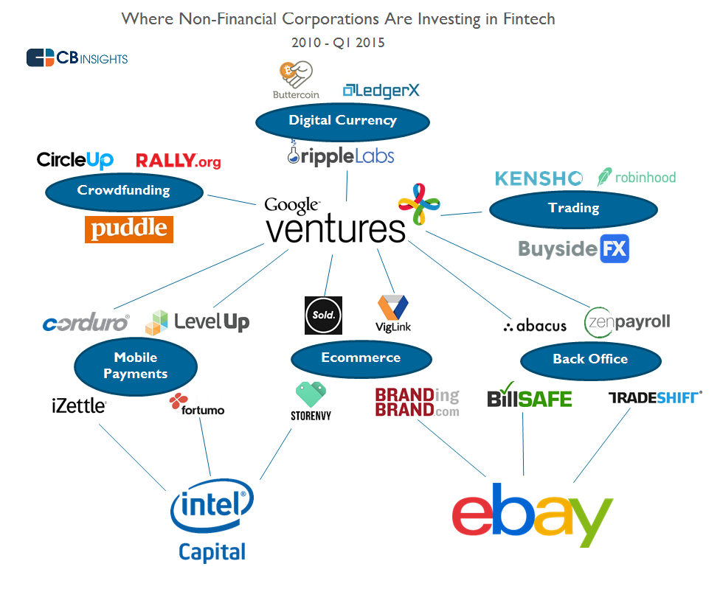
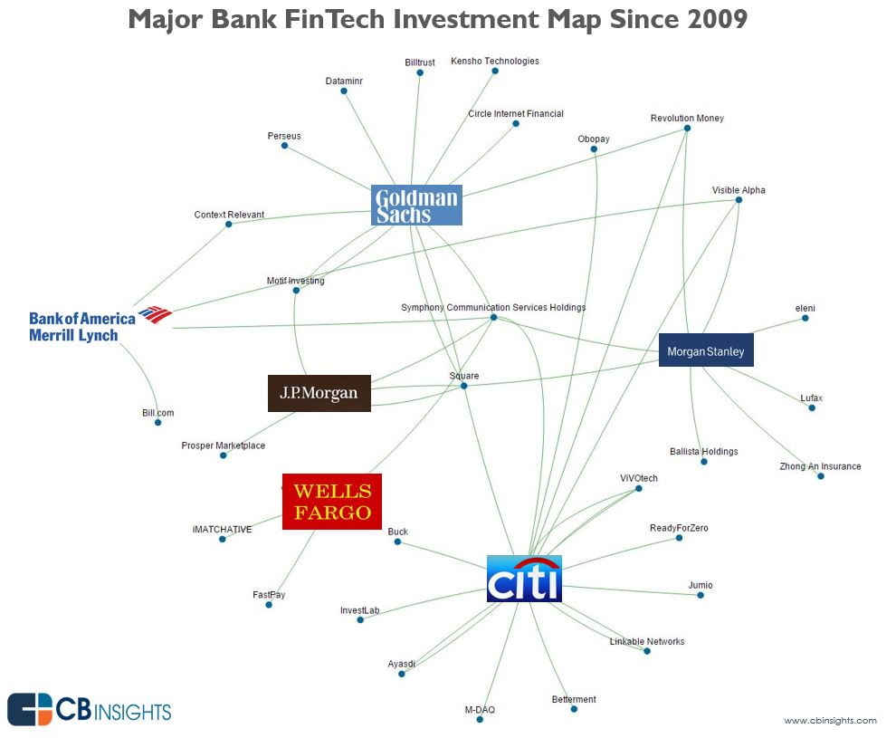
Shared Fintech Infrastructure and Intertwined Bank - Fintech-Tech Firm Relationships
Many financial firms and banks invest in the same fintechs.
Unanalyzed dependencies and feedback loops emerge, raising overall risk.
The market becomes more homogenized and flat with interdependencies.

Slide 11
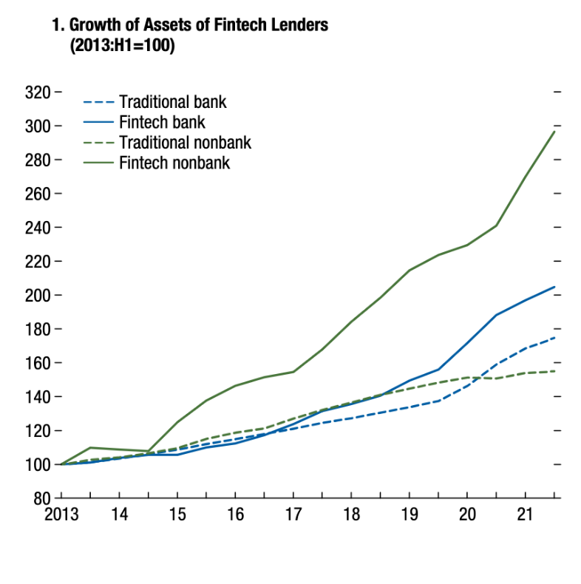
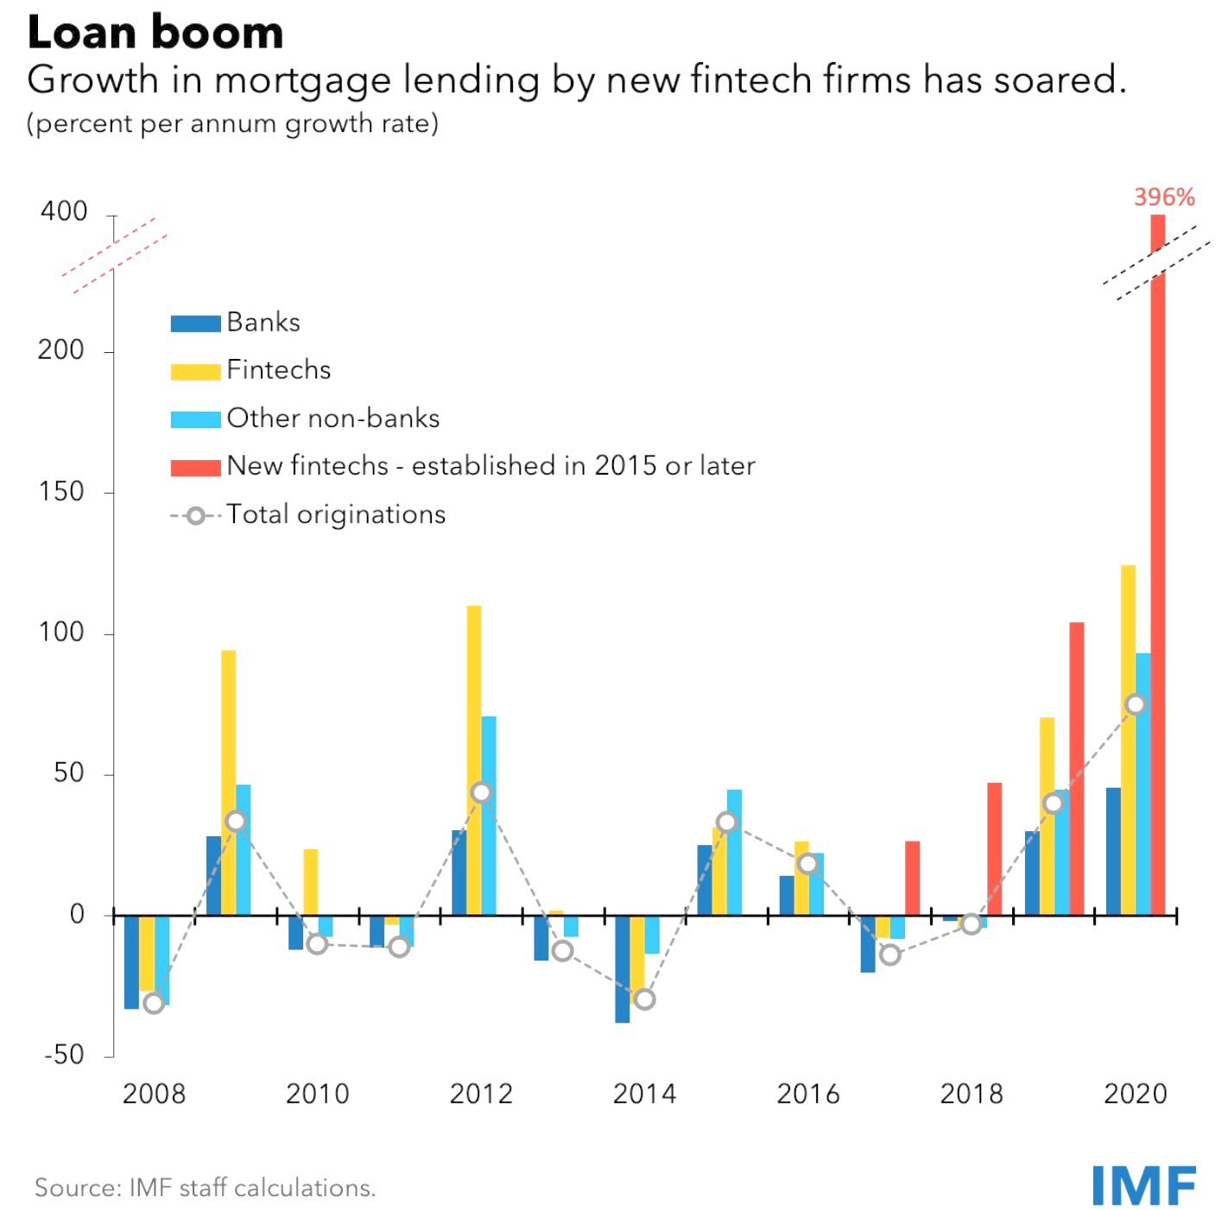
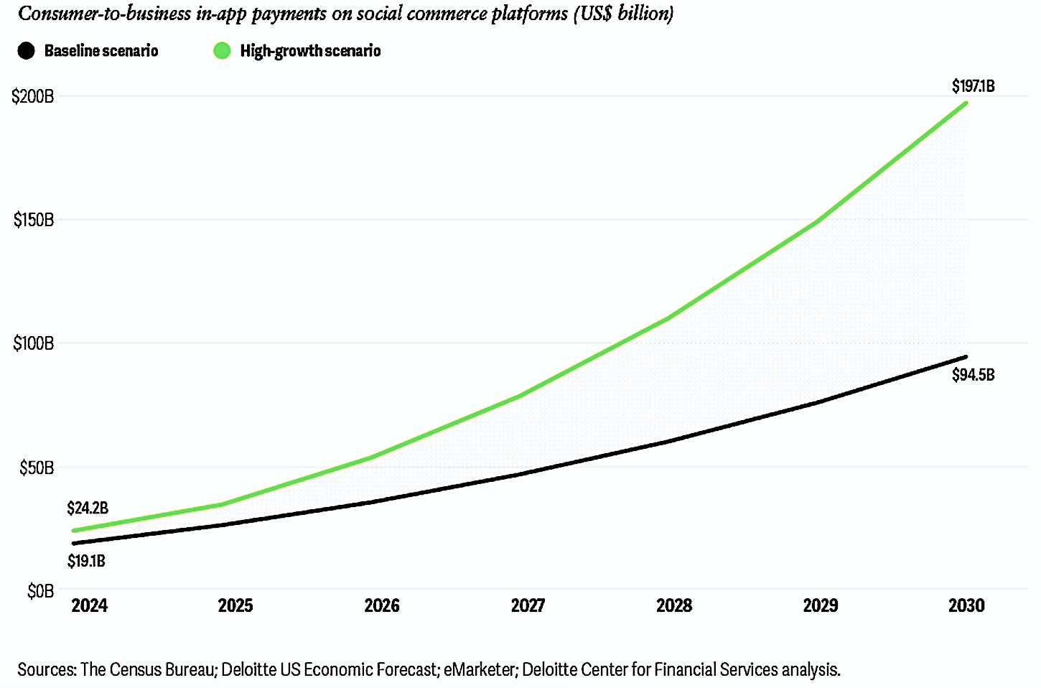
From Mortgages to Lending Fintechs Continue Their Growth

Slide 12
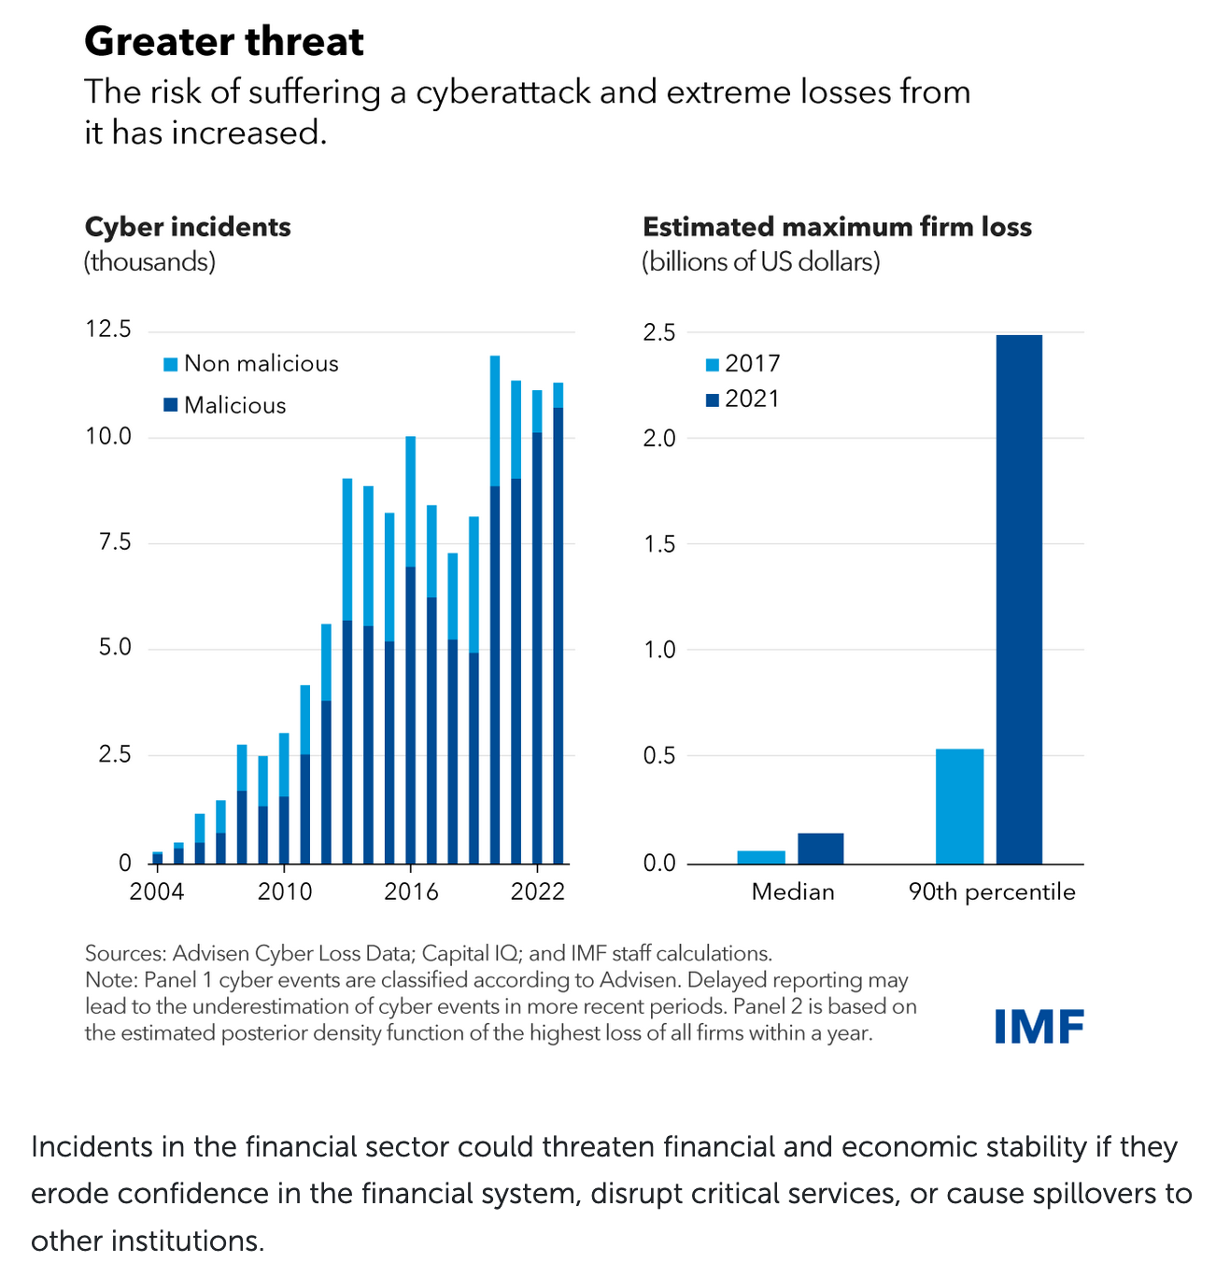
Kamiya and others (2021) studied the likelihood of
cyberattacks that involve the loss of personal information in a sample of US firms. They found that firms that experience such cyberattacks are larger and older; are more profitable; are less risky; have better future growth opportunities, higher leverage, and
more asset intangibility; and invest less in capital expenditures and research and development.
Notes:
https://www.imf.org/en/Blogs/Articles/2024/04/09/rising-cyber-threats-pose-serious-concerns-for-financial-stability
Global Financial Stability Report 2024
file:///Users/a/Desktop/text.pdf

Slide 13
In-House Innovation & Patents

Slide 14
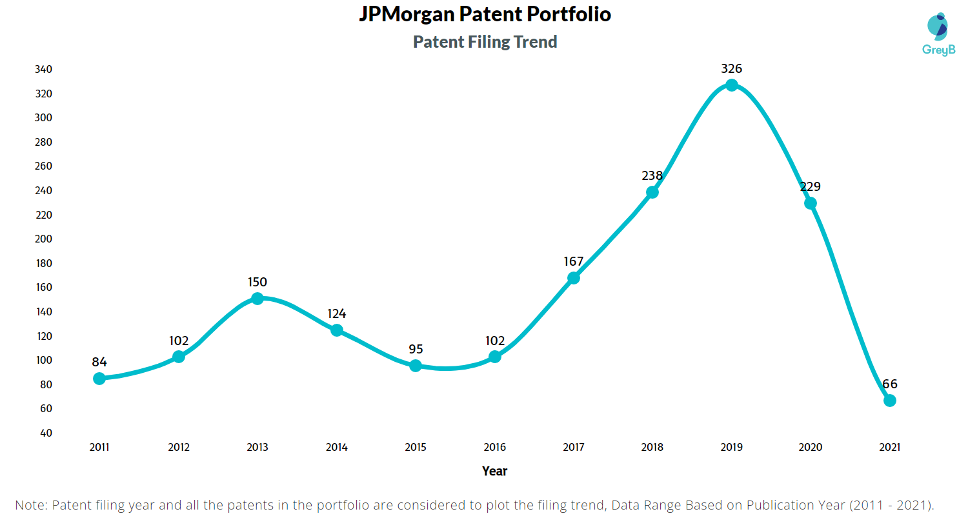
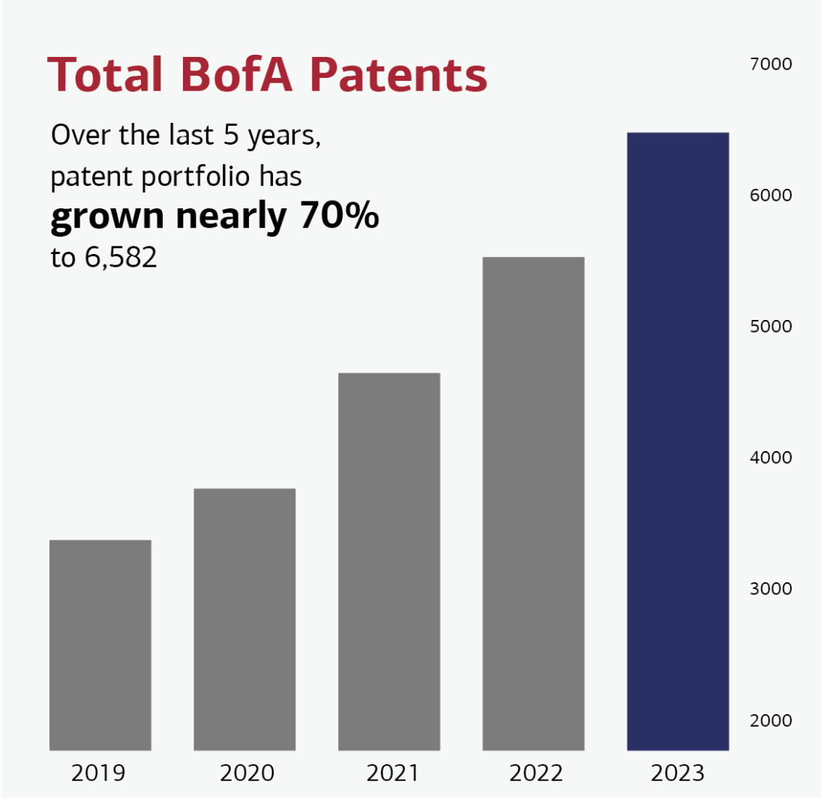
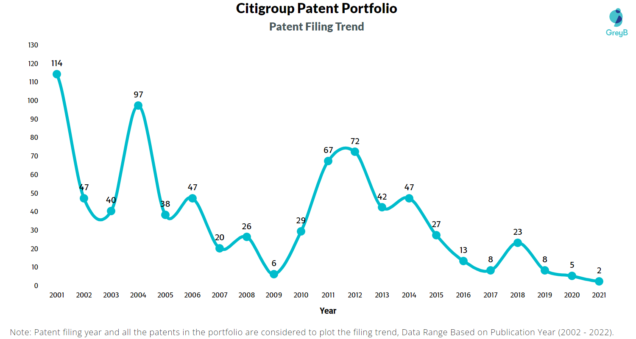
Bank Patents and Innovations are Still In Early Phases
Some firms have special emphasis on patents
(Bofa, Capone, JPM etc).
Number of patent filings are small and localized for most firms.
Notes:
https://www.oliverwyman.com/our-expertise/insights/2024/may/bank-fintech-synergy-can-drive-m-a-success.html

Slide 15
Third Party Innovation:
Collaborative Fintech and Mergers

Slide 16
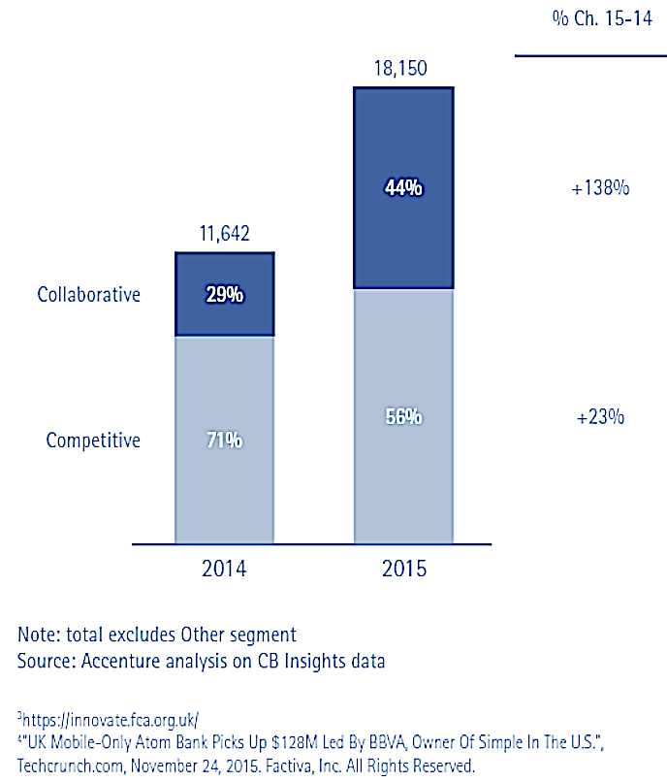
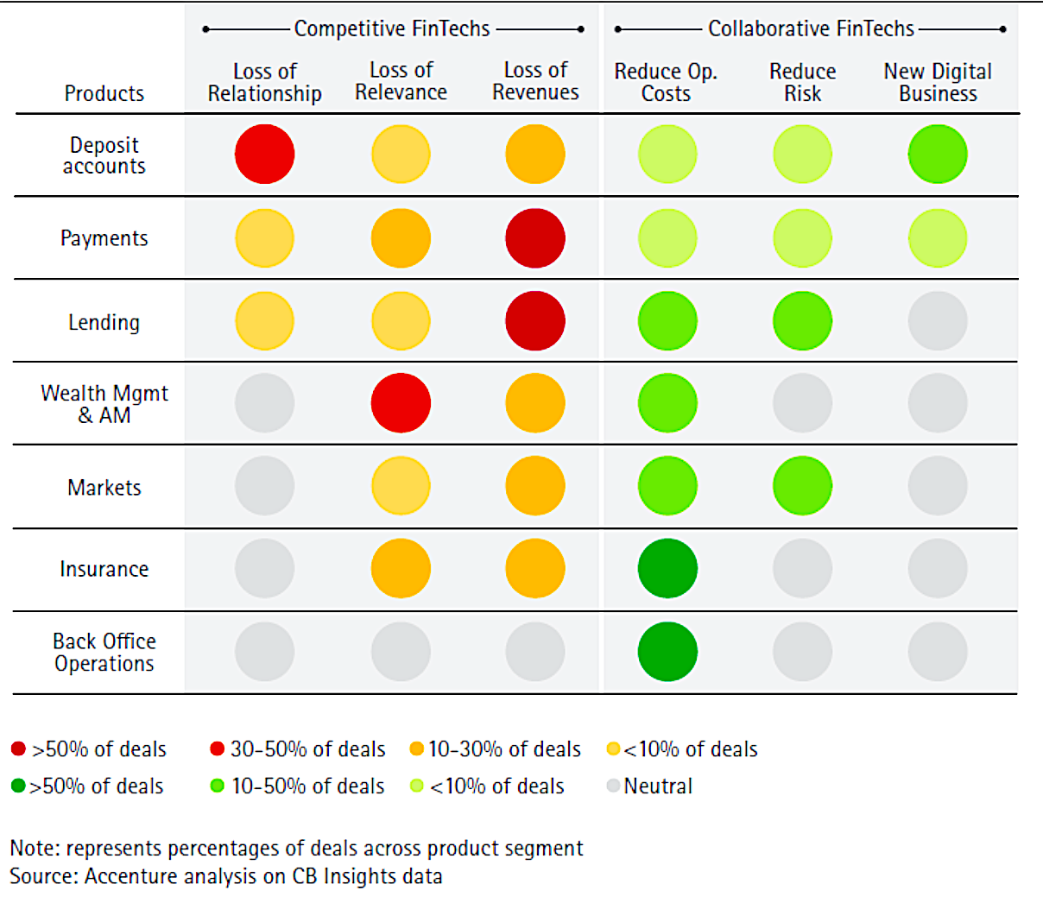
Collaborative Fintech Has been Rising
Fintech Activity from Competitive vs. Collaborative Perspective
(Number of Deals)
Accenture Fintech and Evolving Landscape 2016

Slide 17
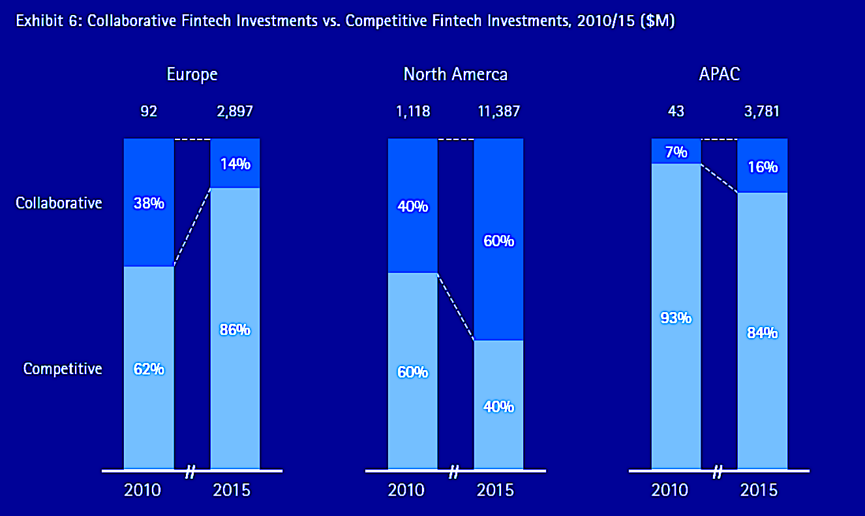
Globally Collaboration - Competition Breakdown Diverges
In APAC and Europe Competitive Fintechs dominate
In North America Collaboration is dominant

Slide 18
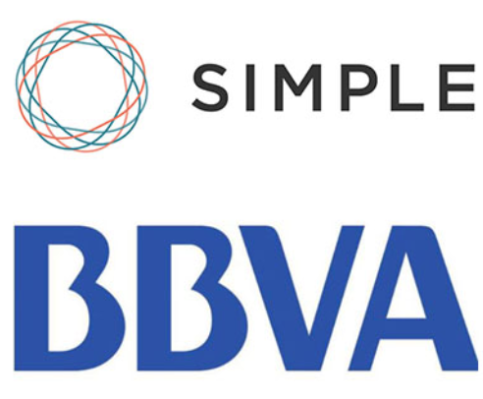

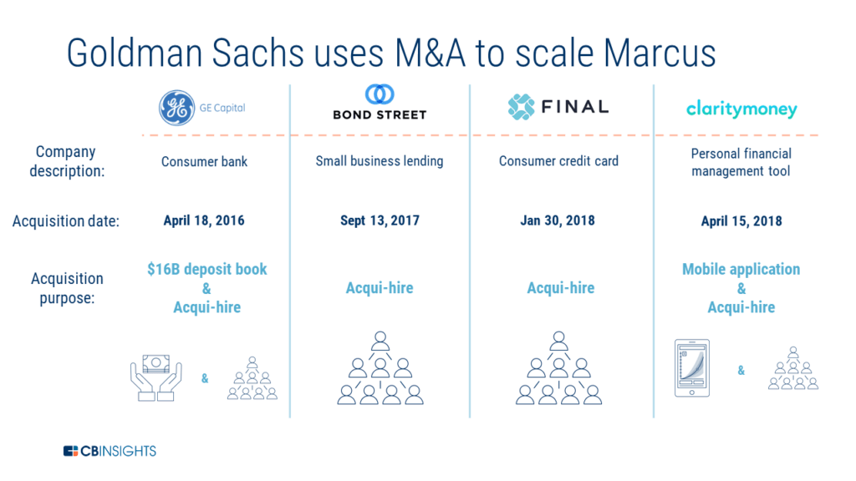
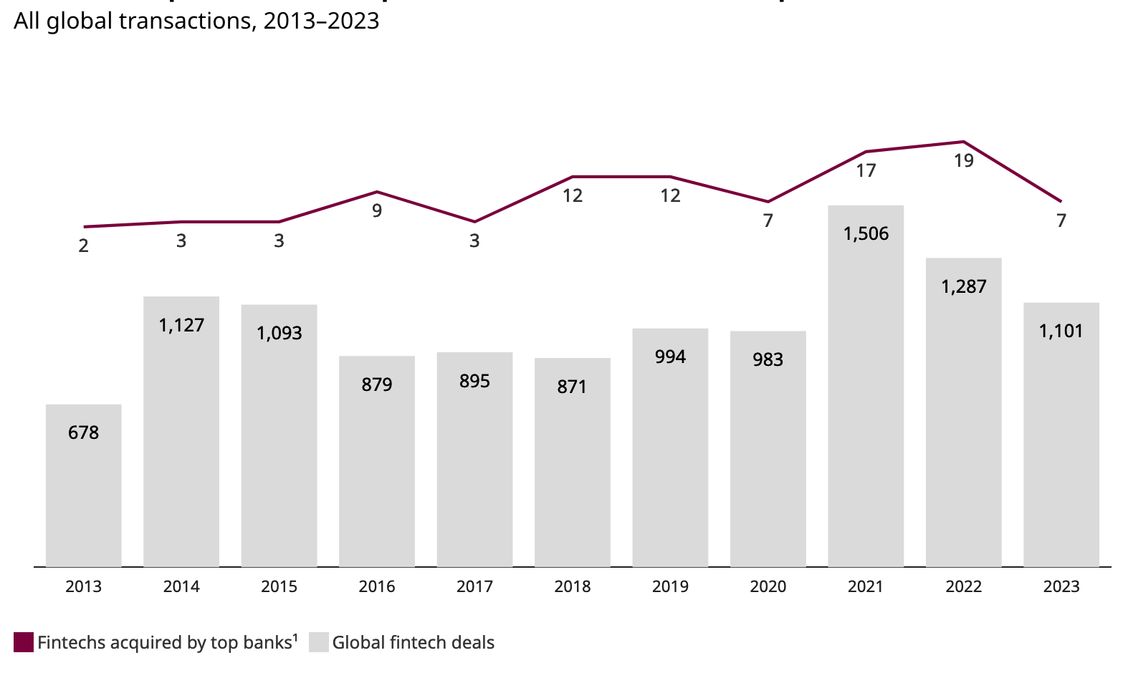

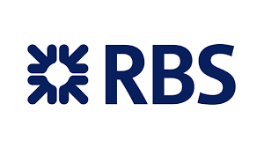
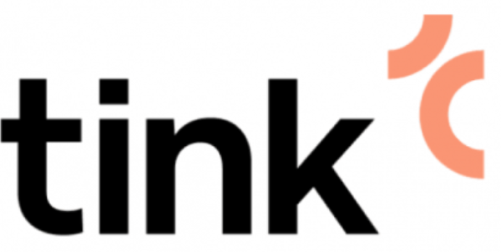

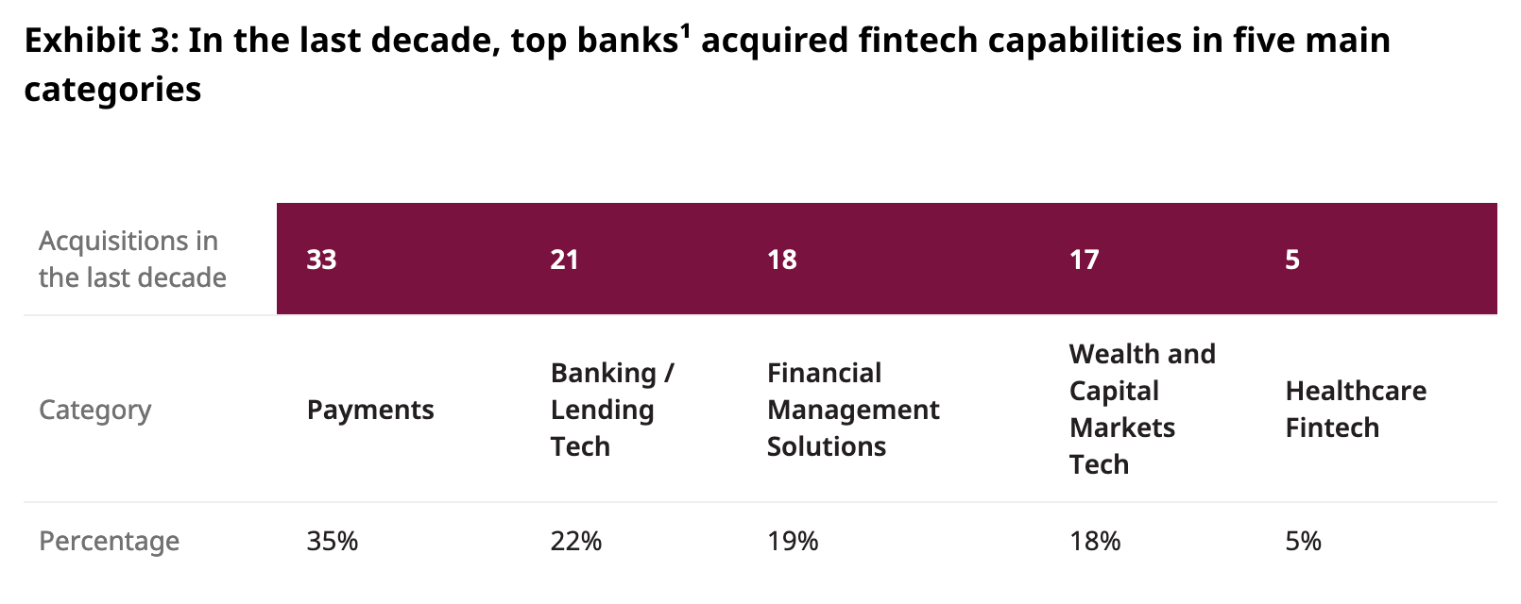
Banks Leverage Fintechs for Number of Purposes
Fintech Mergers are Still Relatively Small
Payments, Lending, Wealth/Capital Markets, Fin Management among the biggest investment areas
Banks made less than 1% of all fintech acquisitions from 2013 through 2023. Top 50 US and top 15 Canadian and International Banks only 94 fintech acquisitions were completed in the past 10 years.
Satellite
Merger
Financial Commitment
Channel
Supplier
Low
Low
Brand Commitment

Slide 19
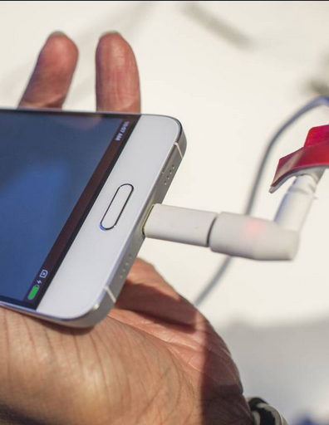
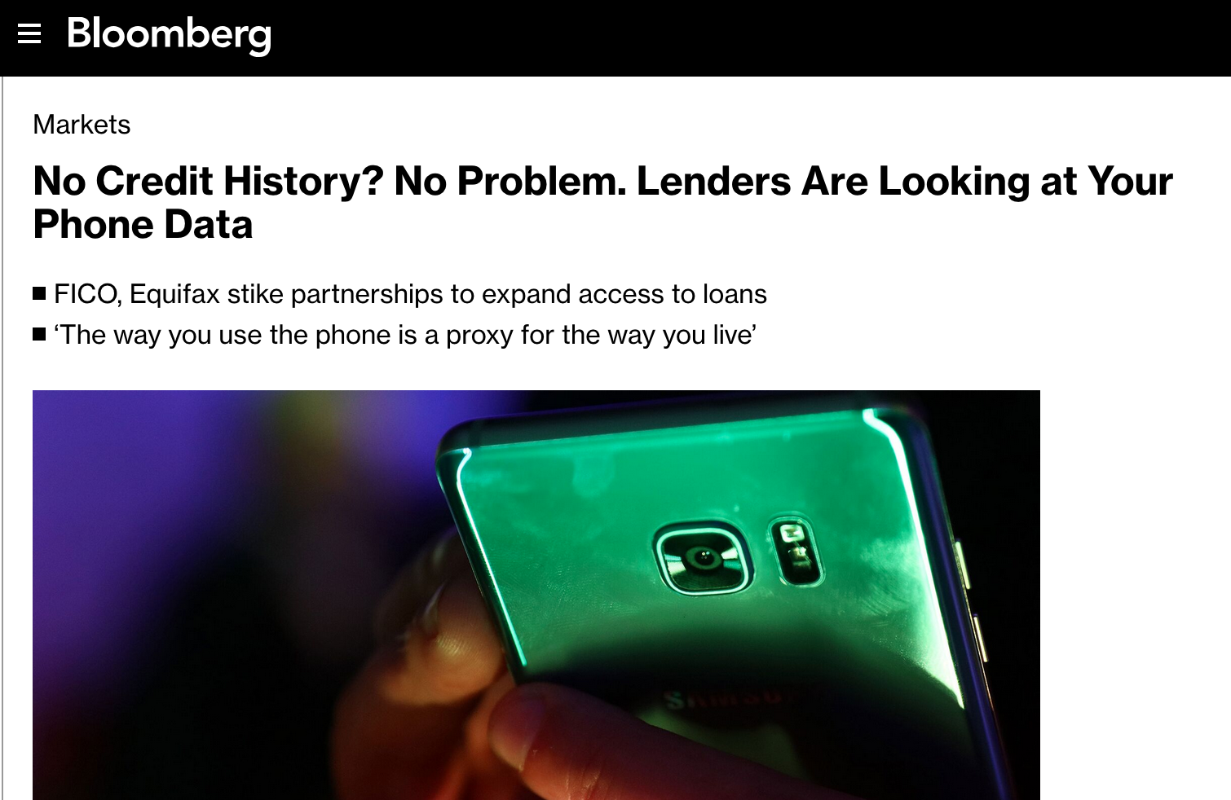

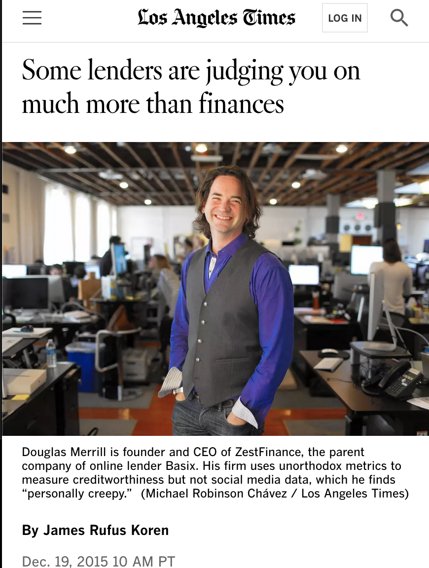
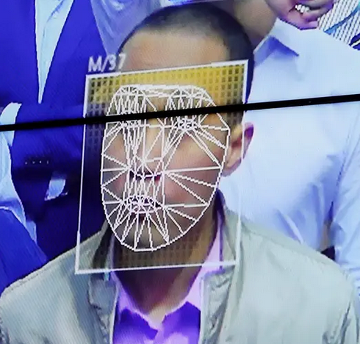
Your Face is Your Credit Score
All Mobile Phone Data is Fair Game for Credit?
Phone Charge Level for Creditworthiness?
What Your Face May Tell Lenders About Whether You're Creditworthy - WSJ
Want a Loan in China? Keep Your Phone Charged - WSJ
All Caps means Less Creditworthiness
All Data is Credit Data?
Loan Video Analytics
“Among thousands of factors is whether you type your name with proper capitalization or in all capital letters. “If you fill in your name in all caps, you’re a much higher risk,”” LA Times
From Network Credit score which is your social media contacts credit scores as a proxy to yours, to using all personal data including dating status, all data is considered credit data for fintechs.
Your facial gestures, blinks, voice, everything can be used be emerging lending firms.
From financial institutions to credit unions, everyone is recognizing the value of analyzing video content related to loan applications, customer interactions, and risk assessment. Faster Capital
Notes:
https://fastercapital.com/content/Loan-Video-Analytics--How-to-Analyze-and-Optimize-Your-Loan-Video-and-Image-Content.html

Slide 20
Dangers of The Digital / Fintech Era

Slide 21
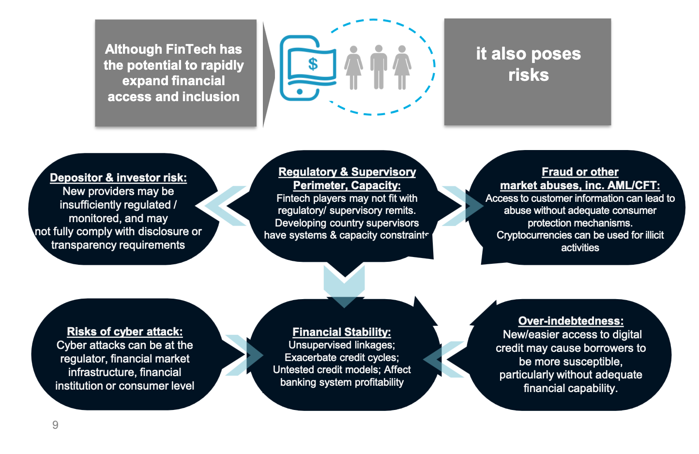
Fast-Moving FinTech Poses Challenge for Regulators
Emerging firms are quickly making inroads into critical financial services, and often taking on more risk than traditional banks.
Pascual et.al.
Digital banks (“Neobanks”) are growing in systemic importance in their local markets.
Vulnerabilities
(1) Higher risk-taking in retail loan originations without
appropriate provisioning and underpricing of credit risk;
(2) Higher risk-taking in the securities portfolio;
(3) Inadequate liquidity management framework.
• Fintech firms not only take on risks themselves but also exert pressure on incumbents. The case study of the US mortgage market presents evidence of a significant negative impact of competitive pressure from fintechs on the income of traditional banks.
[Source: The Rapid Growth Of Fintech: Vulnerabilities and Challenges For Financial Stability]

Slide 22
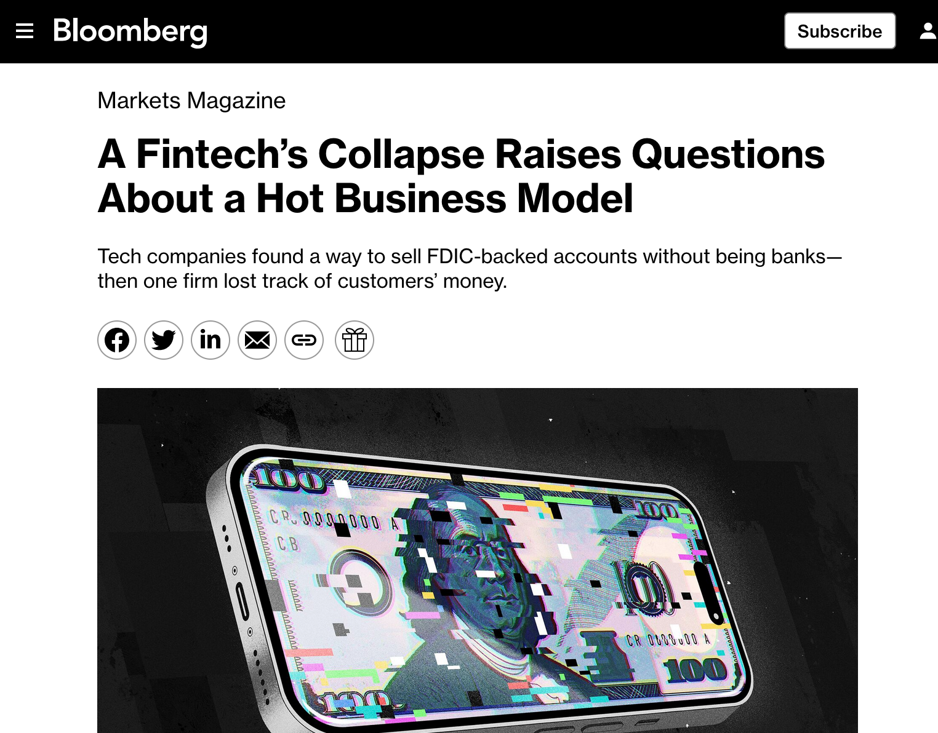
Dangers of Fintech: Too Much Innovation?
Over the past decade, dozens of financial-technology companies have linked up with small and midsize banks across the country.
The idea: The fintechs would create slick smartphone apps and offer useful new services to lure customers, and banks would hold on to the deposits, generating lucrative fees from transactions.
Importantly, the arrangement allowed the fintechs to tout protection from the Federal Deposit Insurance Corp.
The most popular finance apps in the country, including Block’s Cash App, PayPal and Chime, partner with banks instead of owning them. They account for 60% of all new fintech account openings, according to data provider Curinos. Block and PayPal are publicly traded; Chime is expected to launch an IPO next year.
Notes:
https://news.bloomberglaw.com/banking-law/a-fintechs-collapse-raises-questions-about-a-hot-business-model
https://augaf.com/reasons-fintech-collapse-unsuccessful-models-why-falling-growth-prospects/
The collapse of middleman Synapse has revealed fintech’s promise of safety as a mirage. More than 100,000 Americans with $265 million in deposits have been locked out of their accounts.
The implications of this disaster may be far-reaching. The most popular banking apps in the country, including Block’s Cash App, PayPal and Chime, partner with banks instead of owning them.
The startups prominently displayed protections afforded by the Federal Deposit Insurance Corp., lending credibility to their novel offerings. Starting May 11, more than 100,000 Americans with $265 million in deposits were locked out of their accounts. Roughly 85,000 of those customers were at Yotta alone, according to the startup’s co-founder, Adam Moelis.
The most popular finance apps in the country, including Block’s Cash App, PayPal and Chime, partner with banks instead of owning them. They account for 60% of all new fintech account openings, according to data provider Curinos. Block and PayPal are publicly traded; Chime is expected to launch an IPO next year.

Slide 23
Backup

