Slide 1
Bank Competition and Strategic Adaptation to Climate Change
Dasol Kim (OFR), Luke Olson (OFR), Toan Phan (FRBR, OFR)
FDIC Conference
September 19, 2024
The opinions and views of the authors do not necessarily reflect the positions or policies of the Office of Financial Research or the US Department of the Treasury.

Slide 2
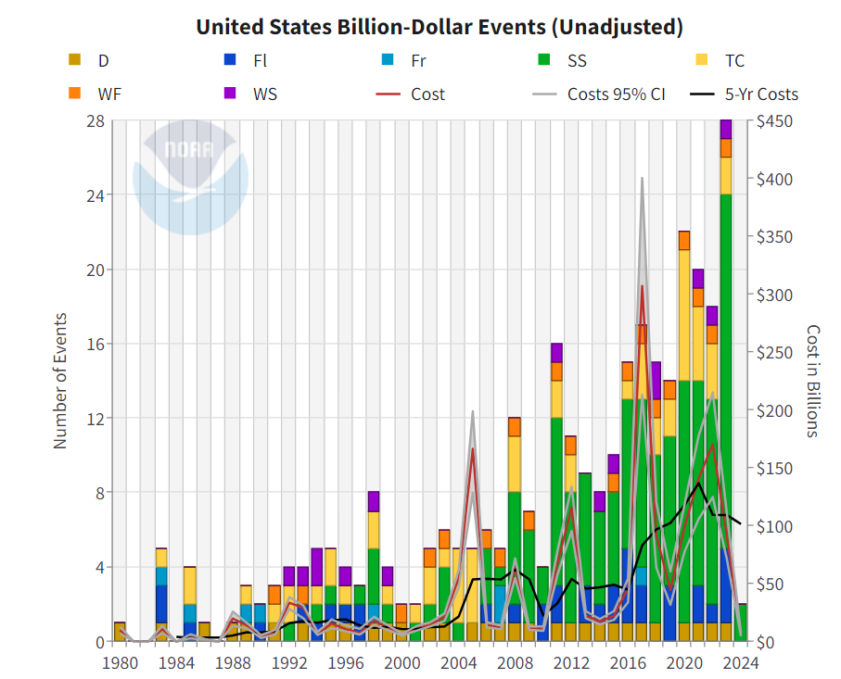

Slide 3
When Models Stop Working…
Hurricane Harvey is one of the most expensive natural disasters in U.S. history, estimated to have caused $125 billion in damages.
  Up until that point, it was rivaled only by Hurricane Katrina ($125 billion) in 2005, Hurricane Sandy ($65 billion) in 2012, and Hurricane Ike ($29 billion) in 2008.
Hurricane Harvey was distinguished from prior disasters due to the prevalence of anthropogenic climate change markers (Trenberth et al., 2018).
  Unlike prior disasters, most of the damages came from inland rather than coastal flooding.
These markers of climate change challenged validity of existing models, creating uncertainty in how to properly project losses due to disasters going forward (Risser & Wehner, 2017).

Slide 4
Motivation
Emerging risks, such as climate risks, are challenging to manage as it is unclear which risk models are appropriate to estimate losses.
  Climate change makes the distribution of disaster risks nonstationary.
  Uncertainty of nonstationary processes renders learning difficult.
Management of climate risks complicated by joint processes related to learning, quantifying exposures, and projecting losses.
  Data on rare disasters are limited.
Financial regulators face similar challenges, making it difficult to monitor and supervise the management of such risks.

Slide 5
Motivation (cont.)
How do financial institutions adapt to emerging risks? Are there strategic interactions in adaption choices?
  Strategic substitutes: Informed banks may curtail risky lending, shifting risky allocations to uninformed competitors.
  Strategic complements: Despite informational advantages, informed banks may choose not to adapt when competitors do not.
Strategic interactions in adaptation behavior is not well understood.
  Barlevy and Veronesi (2008); Hellwig and Veldkamp (2009); Mele and Sangiorgi (2015); and Goldstein and Yang (2015).
Policy implication: Regulatory proposals have primarily focused on micro- rather than macro-prudential considerations.

Slide 6
Overview
This paper: do banks strategically adapt to climate change?
  What is the role of the adaptation behavior of other banks?
1. Granular confidential regulatory data is matched to high resolution climate data.
  Accurately quantify climate shock exposures (i.e., Hurricane Harvey).
  Bank beliefs to directly identify learning in internal risk models.
2. Methodology to better identify adaptation behavior to climate change.
  Heterogeneity in learning based on exposures to climate shocks.
  Tests on competitive responses in unaffected areas.
The analysis inform competitive dynamics with limited regulatory oversight of emerging risks.
  Currently, supervision of climate risks are limited to specific cases.

Slide 7
Main Results
Future flood risks are reflected on average in bank internal risk models immediately following Hurricane Harvey, indicative of bank learning.
  Effects not present beforehand, grow in years afterwards.
Loan portfolio exposures to properties affected by Hurricane Harvey directly correspond with risk model sensitivities to flood risks outside of affected regions.
  Implies heterogenous bank learning about climate risks.

Slide 8
Main Results (cont.)
iii. Evidence of bank adaption to climate change due to Hurricane Harvey.
  Informed banks curtail risky lending while uninformed banks do not.
iv. Bank competition attenuates adaptation behavior.
  The adaptation effects are isolated to concentrated markets.
v. Informed banks are less likely to adapt when competitors in local markets are uninformed.
  Likewise, informed banks readily adapt only when competitors are also informed.
  Suggests strategic complementarities.

Slide 9
DATA OVERVIEW

Slide 10
Data
Bank regulatory data
  Junior-lien home equity lines of credit from Federal Reserve Board’s FR Y-14M (2014 - 2019).
  Bank internal risk model data from loan probabilities of default (PD).
  Precise location information on property backing the loan.
  Other information on loan and borrower characteristics.
Respondent banks account for 59% share of entire HELOC loan market.
  HELOCs play important role in financial stability (Mian & Sufi, 2011).
  HELOCs cannot be readily securitized, sold off the banks’ balance sheets due to a relatively limited secondary market, mitigating potential selection issues.

Slide 11
Data (cont.)
Climate data
  NOAA HURDAT2 provides satellite data to pinpoint property exposures to hurricane paths.
  First Street Foundation provides property-level estimates to evaluate future flood risk in both areas affected and unaffected by natural disasters.

Slide 12
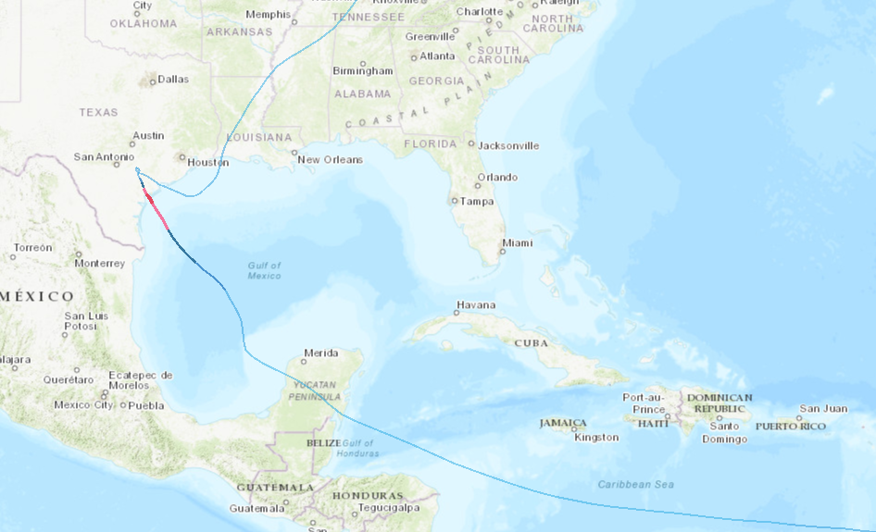
Hurricane Harvey

Slide 13
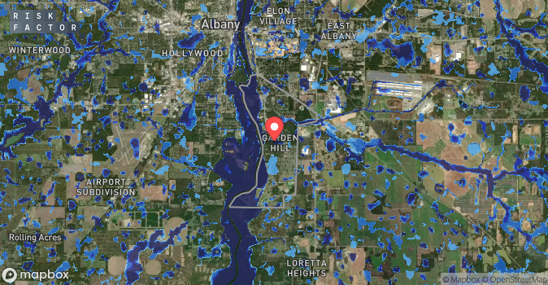
FSF Flood Factor: Radium Springs GA

Slide 14
LEARNING AND INTERNAL RISK MODELS

Slide 15
Learning and Internal Risk Models
We start by testing identifying assumptions for the competition tests.
  → What do internal risk models tell us about bank belief formation related to climate risks around Hurricane Harvey?
We recover weights related to climate risks in internal bank risk models by regressing the loan-level PDs on the flood risk measure.
  The flood risk loadings in this specification should correspond with the model weight associated with flood risks.
  To avoid the confounding effects of areas affected by the hurricane, we exclude TX from the analysis.
The internal models likely include myriad unobservable covariates related to both time-varying credit demand and other supply factors.
→ Employ high-dimensional fixed effect specifications in the spirit of Khwaja and Mian (2008).

Slide 16
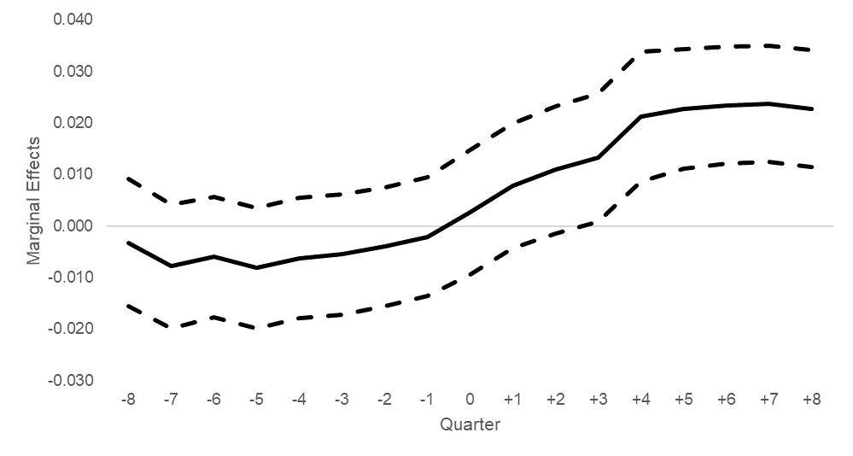
Learning and Internal Risk Models (cont.)
Marginal effects of flood risk on internal risk model default probabilities.

Slide 17
Heterogeneity in Bank Learning
Our analysis requires identification of heterogenous bank learning about climate risks.
Greater hurricane exposures may provide informational advantages to banks on the severity of losses due to climate events.
  Severity of the damages are informative not only for assessing credit risks for borrowers, but also may provide insights into losses associated with a broader set of climate risks.
  Soft information that is otherwise costly to acquire, which may motivate banks to incorporate it into their internal risk models.
→ Identification approach: heterogeneity in learning about climate risks based on exposures to Hurricane Harvey.

Slide 18
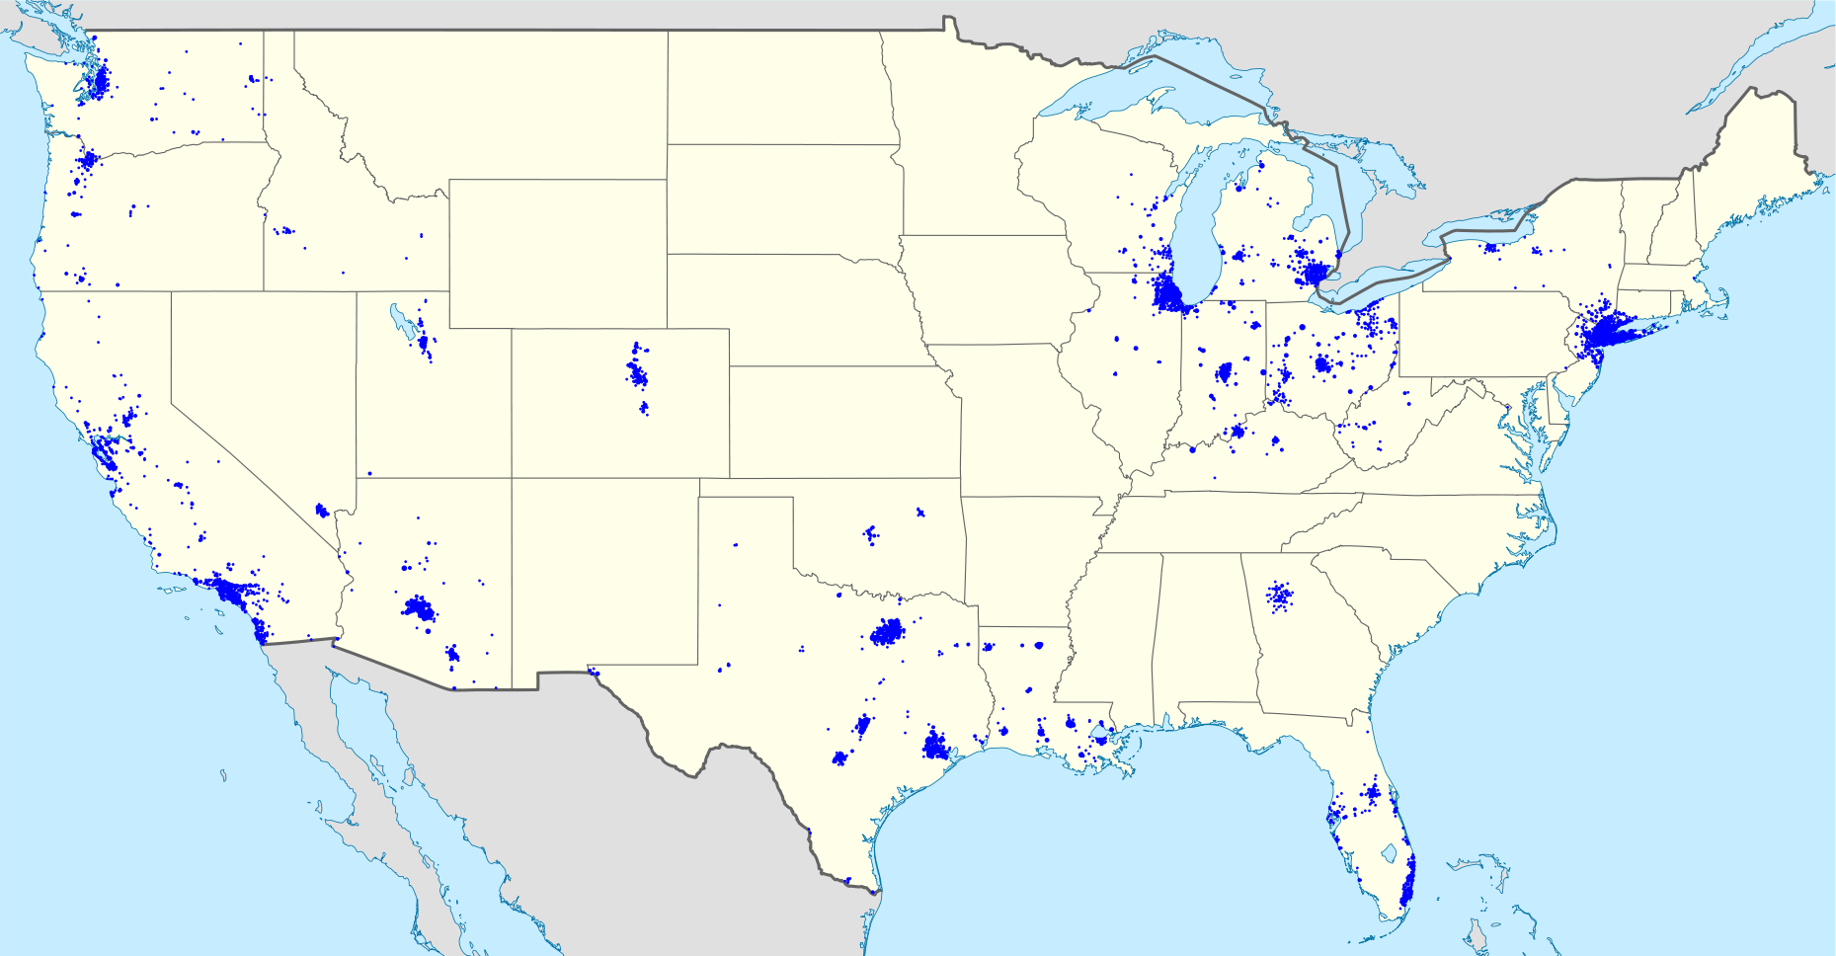
Example: JP Morgan Branch Map

Slide 19
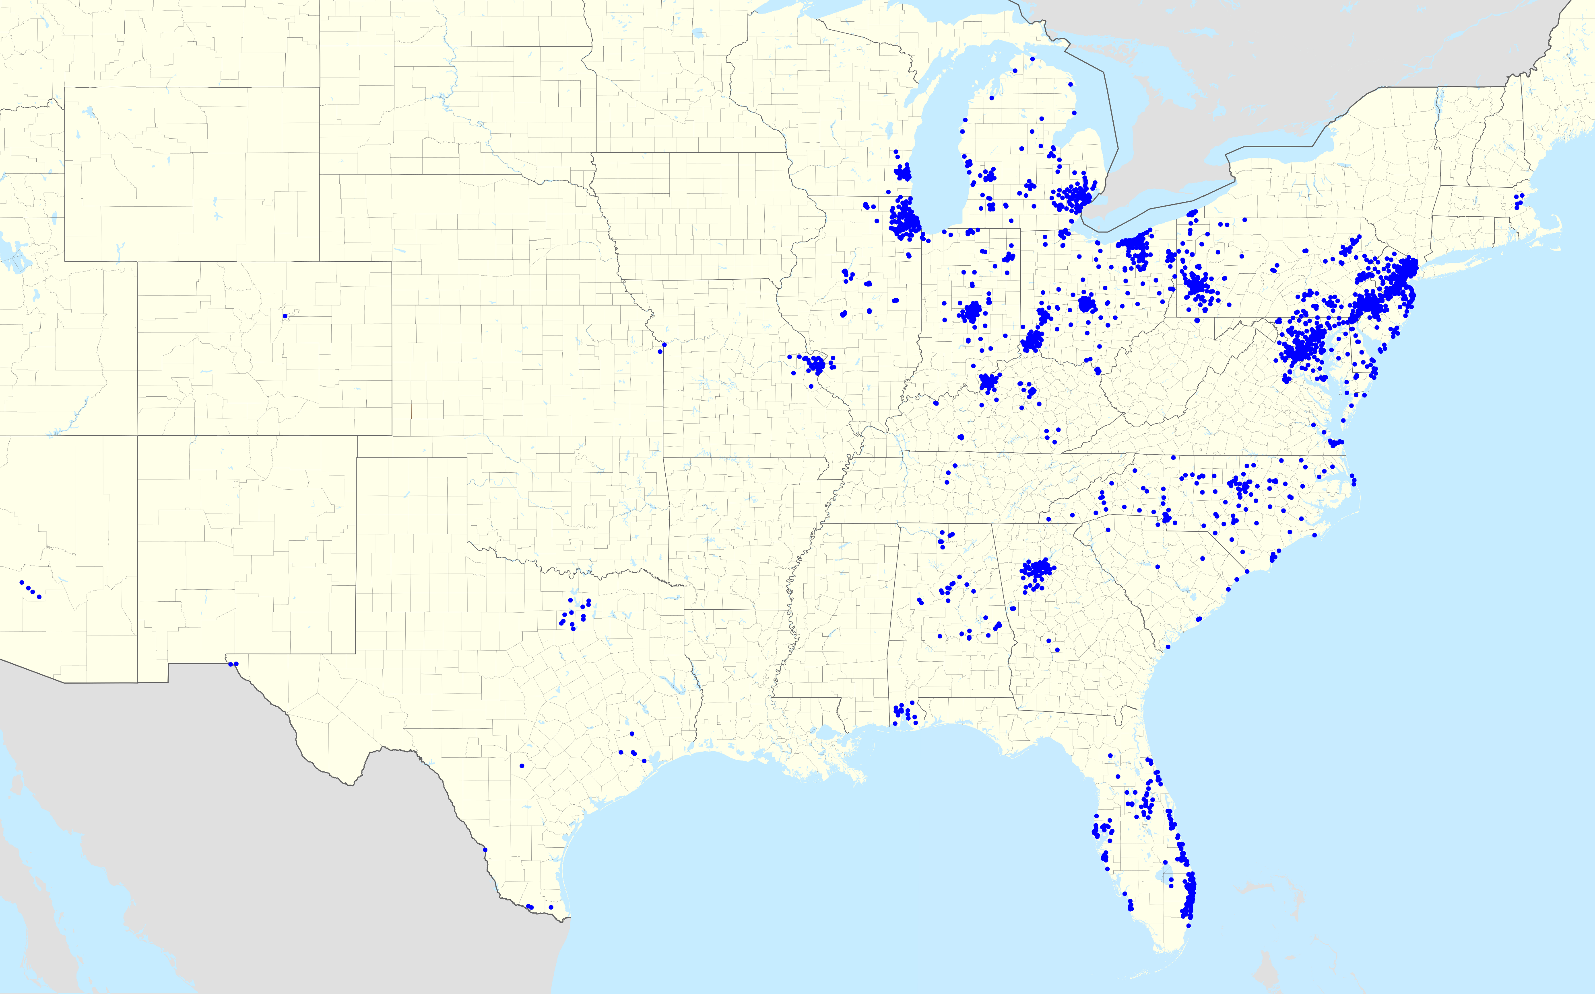
Example: PNC Branch Map

Slide 20
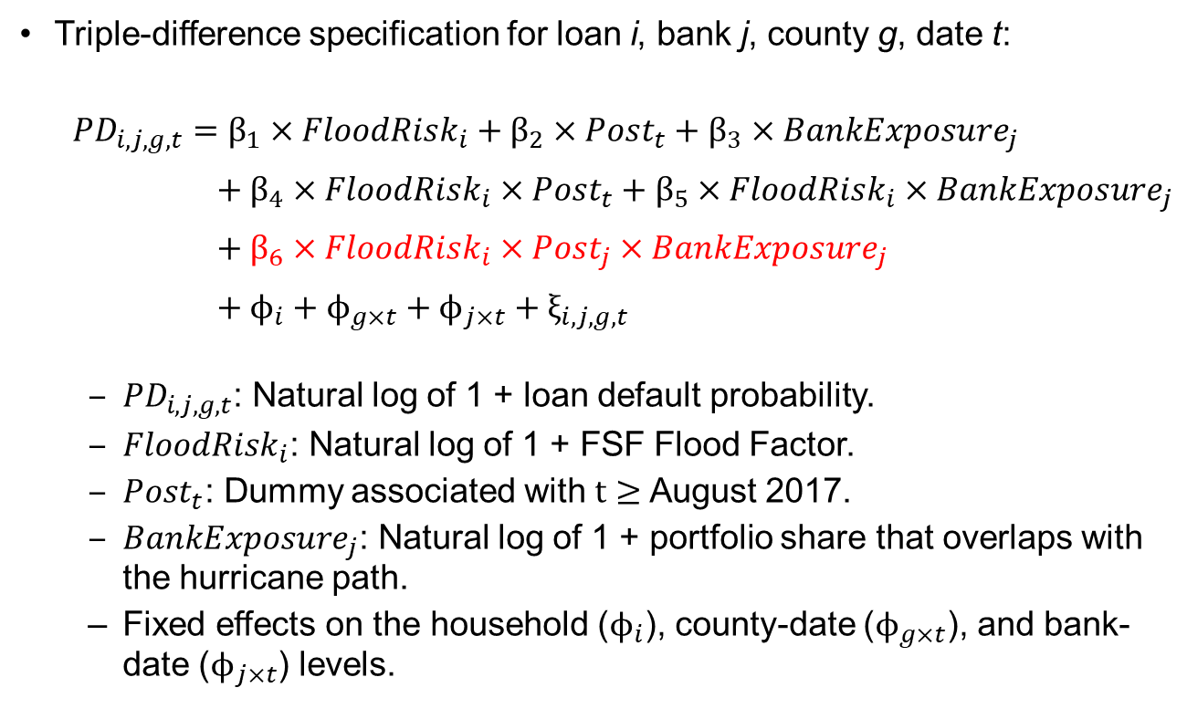
Heterogeneity in Bank Learning (cont.)
Triple-difference specification for loan i, bank j, county g, date t:
${PD}_{i,j,g,t}=β_{1}×FloodRisk_{i}+β_{2}×Post_{t}+β_{3}×BankExposure_{j}$
$+ β_{4}×FloodRisk_{i}×Post_{t}+β_{5}×FloodRisk_{i}×BankExposure_{j}$
$+ β_{6}×FloodRisk_{i}×Post_{j}×BankExposure_{j}$
$+ ϕ_{i}+ϕ_{g×t}+ϕ_{j×t}+ξ_{i,j,g,t}$
  ${PD}_{i,j,g,t}$: Natural log of 1 + loan default probability.
  $FloodRisk_{i}$: Natural log of 1 + FSF Flood Factor.
  $Post_{t}$: Dummy associated with $t≥$ August 2017.
  $BankExposure_{j}$: Natural log of 1 + portfolio share that overlaps with the hurricane path.
  Fixed effects on the household ($ϕ_{i}$), county-date ($ϕ_{g×t}$), and bank-date ($ϕ_{j×t}$) levels.

Slide 21
Heterogeneity in Bank Learning (cont.)

Slide 22
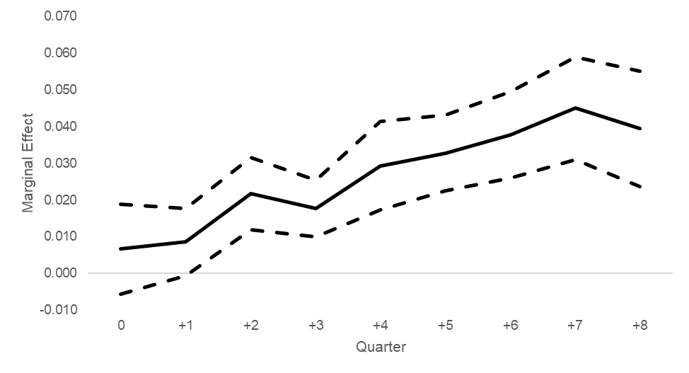
Heterogeneity in Bank Learning (cont.)
Marginal effects of the triple-differences over time

Slide 23
BANK ADAPTATION AND COMPETITION

Slide 24
Adaptation and Competition
We next turn our attention to tests on bank adaptation behavior and the effects of competition.
  Given that climate risks are costly to hedge, banks may choose to divest from certain markets where risks are higher.
  Particularly true for junior lien property loans, as insurance payouts are unlikely to cover all the losses.
Our tests focus on the effects on a bank’s competitive position based on changes in market share in the years following Hurricane Harvey.
  Adaptation implies that informed banks should lower market share.
  We use loan portfolio exposures to the hurricane in order to differentiate informed versus uninformed banks.

Slide 25
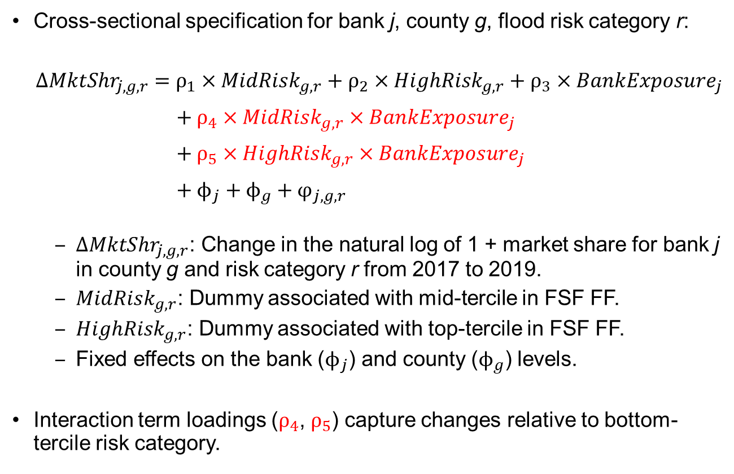
Adaptation and Competition (cont.)
Cross-sectional specification for bank j, county g, flood risk category r:
${∆MktShr}_{j,g,r} =ρ_{1}×MidRisk_{g,r}+ρ_{2}×HighRisk_{g,r}+ρ_{3}×BankExposure_{j}$
$+ ρ_{4}×MidRisk_{g,r}×BankExposure_{j}$
$+ ρ_{5}×HighRisk_{g,r}×BankExposure_{j}$
$+ ϕ_{j}+ϕ_{g}+φ_{j,g,r}$
  ${∆MktShr}_{j,g,r}$: Change in the natural log of 1 + market share for bank j in county g and risk category r from 2017 to 2019.
  $MidRisk_{g,r}$: Dummy associated with mid-tercile in FSF FF.
  $HighRisk_{g,r}$: Dummy associated with top-tercile in FSF FF.
  Fixed effects on the bank ($ϕ_{j}$) and county ($ϕ_{g}$) levels.
Interaction term loadings ($ρ_{4}$, $ρ_{5}$) capture changes relative to bottom-tercile risk category.

Slide 26
Adaptation and Competition (cont.)

Slide 27
Mechanisms
To further investigate mechanisms underlying the results, we consider two additional tests that exploit heterogeneity in the effects.
How do competitive conditions affect adaptation behavior?
What is the role of the adaptation behavior of competing banks?

Slide 28
General Competitive Conditions
HHI: HELOC market concentration for the local market.
Competitive conditions have an attenuating effect on adaptation behavior.
  Example: Issuing risky loans may help maintain deposit franchises in competitive markets due to product bundling (DeYoung and Rice 2004).

Slide 29
Competitor Adaptation Behavior
PeerExposure: Average BankExposure of local competitors.
Results suggest strategic complementarities in adaptation behavior.
  Race-to-the bottom (Di Maggio et al., 2019).

Slide 30
Concluding Remarks
We provide evidence for strategic bank adaptation to climate change.
  Direct evidence on bank adaptation behavior following Hurricane Harvey in 2017.
  Behavior of competing banks directly influence adaptation behavior.
Limited supervisory oversight of emerging risks may provide banks a margin for risk-shifting.
  In turn, enhanced guidance is likely to mitigate such behavior.
  Because climate and other emerging risks are rapidly evolving, there may be some aspects of risk that are overlooked.

Slide 31
THANK YOU!

